Slide 1
VMO2UK Ops

Slide 2
Prodapt solution aligned to RFP asks
Value already delivered
Comprehensive solution
Short- and medium-term goals on CSI
G-AI thoughts and approaches
Robust governance structure
Key people and key SMEs retained
SLA and KPI compliances
Commercials

Slide 3
Prodapt solution aligned to RFP asks

Slide 4
Prodapt Alignment to RFP Slides - I

Slide 5
Prodapt Alignment to RFP Slides - II

Slide 6
Value already delivered

Slide 7
Value already delivered by Prodapt - I

Slide 8
Value already delivered by Prodapt - II

Slide 9
Comprehensive solution

Slide 10
Comprehensive Solution - I

Slide 11
Comprehensive Solution – II

Slide 12
Short- and medium-term goals on CSI

Slide 13
Short- and medium-term goals on CSI - I

Slide 14
Short- and medium-term goals on CSI - II

Slide 15
G-AI thoughts and approaches

Slide 16
G-AI thoughts and approaches - I

Slide 17
G-AI thoughts and approaches - II

Slide 18
Robust governance structure

Slide 19
Robust governance structure - I

Slide 20
Robust governance structure - II

Slide 21
Key people and key SMEs retained

Slide 22
Prodapt Alignment to RFP Slides - I

Slide 23
Prodapt Alignment to RFP Slides - II

Slide 24
SLA and KPI compliances

Slide 25
SLA and KPI compliances - I

Slide 26
SLA and KPI compliances - II

Slide 27
Commercials

Slide 28
Commercials - I

Slide 29
Commercials - II

Slide 30
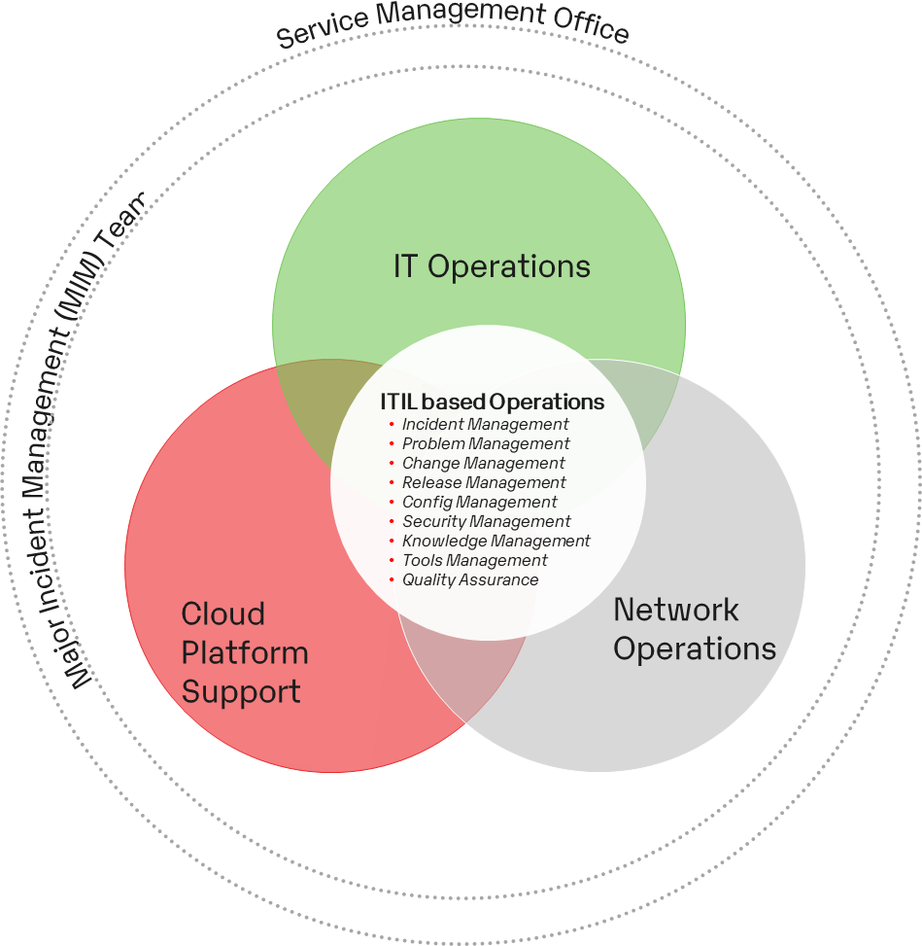
Tailormade Solution aligning with RFP Expectations to support Mission, Business & BAU Operations
Harmonization
Unified Team Leveraging the Synergies across IT and Network
Knowledge Management/Retention
Maintain The Best Practices of Knowledge Retention and Documentation and Scale up to Setup a VMIE University
Opex Reduction
Continue the Journey of Optimizations, Transformations and Shared Services with committed YoY Opex Reduction with Focus on CSI, Automation, Accelerators and Problem Management
Improved User Experience
Leveraging Leading Practices, Pordapt’s Problem Management Platform improving on MTTI/MTTR and Availability
Prodapt Enablers
Integrated Command
AI Ops
Cognitive Automation
Transition Framework
Assets (ProAssets)
Digital Brain (KM)
Flexible Models
Service Maturity Model
App Rationalization Framework

Slide 31

Vision for VMIE and Prodapt to become natural partners through shared values
Vision statement - To be a trusted advisor and partner to VMIE for technology-led transformation that provides measurable business value backed by predictable execution capabilities
Key Impact Areas
Current State
Future State
Business Persona Experience
Stable IT Systems – 20% - YoY Reducing Tickets
Faster Response – 45% reduction in Restoration Time
Leading Practices – Tools, Accelerators and Automations – Reduce Intervention and Improve Experience
Measure End User Satisfaction - Improving NPS
Measuring End To End Experience – Business Metrics Like Mean Time To Instal, Order Fallout Ratios, Payment Failure Ratios etc
Apps, Cloud and Network
Service Levels – Excellent SLs at Tower Levels (100% on L2)
Right First Time % -97% (on L2 BAU) - Good Command on the Towers
CSI – Improvements Aligned to YoY Opex Commitments and Industry Leading Practices
One IT Approach – Guardian Role and View of End To End Service levels across Apps, Infra and Network
Cognitive Elimination – Track % Elimination formalizing the Problem Management Process
Flexibility – Continued Focus on PI, Shared Services, Proactive measures and Automation enabling Flexibility in Staffing
Service Delivery and Governance
Managed Services – Driven by Agreed SL/KPI
Process Maturity – Aligned to ITIL and Industry Leading Practices
SME Productivity – Improving PI YoY
Metrics Based Governance – Bringing in E2E View
Intuitive Dashboards and Reporting – IT and Business KPI
Investment in Innovation Council – Focussed on Top Down Industry Leading Practices

Slide 32



Our Understanding and Expertise in the RFP Asks
Schedule
Scope
Key Activities
Schedule 1
Service Desk & Monitoring
Level 1 - Service Desk & Monitoring
Level 1 Support Window: 0700 x 2200 X 365 days
Monitoring : 24x7x365
Front line end user Support (Email/Call/Tickets)
Manage ticketing system and FLF
Service request handing
Monitoring of VMIE IT & Network components including vendor systems
DSOC : Incident Logging, Monitoring ( IT & Network), Reporting, Vendor engagements
Schedule 2
App Support
Application Support- Wholesale , Retail , IT & Network
Support Window : 0700 x 1900 (Mon –Fri)
On-call support - 24x7 for P1 & P2
Application support (Local (Legacy) , Digital first & Kennedy Steams) – Wholesale & Retail
24x7 Monitoring for Priority Applications
IM, CM & PM Process handling
Asset and configuration management
Triaging, SMEs, Reporting, Knowledge Books update and Review.
Schedule 3
B2B Operations
B2B Service Desk- Out of Hours Support, Wi-fi- L1 & L2
Support Window - 24 x 7 x 365 days
UK OOH Support, UK Support Wifi 2nd Line & Sitel Wifi 1st Line
Open and manage Remedy Force tickets
Troubleshoot wifi equipment (internal)
Troubleshoot end user equipment/issues
Schedule 6
Service Management & ORM
Service Management & Operational Readiness Capability
Hours of Operations : 0800 – 1730 (Mon –Fri)
Service Management & Operational Readiness Capability
Service Management &ORM: Service Governance, Operational readiness, Change ,Problem Management
Continuous Improvement – Automations, Knowledge base
Schedule 7
Tiger /MIM
Major Incident Management/Tiger Team
Hours of Operations : 0800 - 1730 (Mon –Fri)
On Call support – 24x7x365 for P1 & P2
Manage Severity Tickets (P1/P2) – E2E until closure - IT ,Network, Security
Drive diagnosis/troubleshooting by setting up Co-ordination calls/war room calls
Keep Customers/Stakeholders informed by sending regular comms/update
Monitor SLA Compliance across towers
Core Applications
Evolving App stack
Tech Stack
Transformation Focus
Core BSS/OSS
Selfcare, Assisted Channel
Integration Apps/APIs
3rd Party Apps
Kennedy Retail and Wholesale
RPA, Incident Tools
Kennedy Retail Apps
Kennedy Wholesale Apps
Mobile Transformations
Billing Transformations
ITIL , ServiceNow
Microsoft .Net, Python, Java, Camunda, PostgreSQL, Kafka, Rest API ,Swagger |SQL, Kibana, Microservice
GCP,|AWS, Devops
Kennedy - Salesforce, Ciena BP, Clarify , Nokia, ESRI, FCAPS ,Witbe, Spectrum ,Nagios
Kennedy Order Monitoring Dashboards
Auto remediation & automation through Generative AI
Process Improvements
Defect error prevention analysis through Trend & Data analysis
Industry Best Practices & Quality Improvements
Knowledge Base & SOPs
Establish sustainable operations enabled by intelligent automation to handle tactical issues and deliver long-term solutions to optimize business outcomes

Slide 33







We have delivered results in the past and have a data backed plan for future
Q2’23
Q1’23
Q3’23
2021-22
20+ Kennedy proactive monitoring Incidents throug autoations by DSOC (Retail)
Incident Reduction, Customer/ Business impacts reductions, Automation & Reporting
Q4’23
Delivered in 2021 &22
2023- Key Focus
Orders Comet, Clarify, SOM
MS Team –Order failure Alerts
Order Fallout Auto Fix–Phase 1
Order Fallout Auto Fix –Phase 2
2 Password reset Bots
Reduce Incidents
Automations
4 Starter Pack Bots
Order failure Alerts
Starter Pack Automation-Phase 3
Starter Pack Automation-Phase 4
Termination Process Automation-Phase 1
Improve TAT
IIS Clean up Bots
Ui Path Migration
Wholesale Order Monitoring Bots
Dashboards
& Reports
12+ Health check Bots
Graph API integration with BOTs (Security Fix)
Automate Tasks
Dashboard – Health checks
Problem Analysis, RCA based Automations, Improvement suggestions
Ph1:Retail: Comet ,Clarify, SOM PH2: Wholesale: ZIRA,SOM| Reports –Order trend & Failure
Order status Single view Discovery: E2E Order Monitoring Retail & wholesale Order - Alarms Order Monitoring Dashboard
Business Reports
Dashboard -Business Report
Process Improvements- All
Increase Monitoring coverage
Process
Process improvements : Kennedy, BAU - SOPS, Blue Book, Incident Process , Weekly/ Quaterly Improvement Reviews
Closed /
In Progress
In Queue
In Queue
In Queue

Slide 34

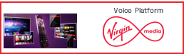
Prodapt is best placed to deliver given the experience, track record and credentials of Continuous Service Improvement
Schedule
Scope
Key Value Delivered by Prodapt
Schedule 1
Service Desk & Monitoring
AS-IS Scope Managed By –
Incremental Scope - Additional Coverage (ITHD)
53%
Reduction in Phone
Support Volumes
20%
YoY Reduction resulting in 20% Opex Savings To Date
12
Automations / Improvements
Schedule 2
App Support
AS-IS Scope Managed By –
Incremental Scope - None
40%
Reductions in Critical Tickets
50+
Health Checks / Automations
68%
Reduction in Restoration Hours
Schedule 3
B2B Operations
AS-IS Scope Managed By –
Incremental Scope - None
12+
Process Improvements
20+
Shift Left From L2 and Improvement in FCR
80%
First Level Rate by Wifi L1
Schedule 5
Cloud Platform
AS-IS Scope Managed By –
Incremental Scope – Additional Coverage
30
Environments built
100%
Automated Cloud built
35+
GCP Services Enabled
Schedule 6
Service Management & ORM
AS-IS Scope Managed By –
Incremental Scope – None
30%
Ops Readiness
25+
Service Management Metrics
70+
KT Sessions and 9 Vendors Onboarded
Schedule 7
Tiger / MIM
AS-IS Scope Managed By –
Incremental Scope – None
20%
Reduction in P1 YoY
Improved Management Comms & Increased RCA Fixes
70+
KT Sessions and 9 Vendors Onboarded
Schedule 4
Network Operations
AS-IS Scope Limited to support NOSD function
for DTV & Voice Platforms
Incremental Scope - Level 1 & Level 2 Network Operations
DTV
Our Network Credentials to be highlighted
Completely Own and Excellent Delivery Credentials in 6 of the 7 Schedules
Proven Industry Experience and Tools in Network Ops
Improved User Experience and Optimized Opex Across the Portfolio Managed

Slide 35
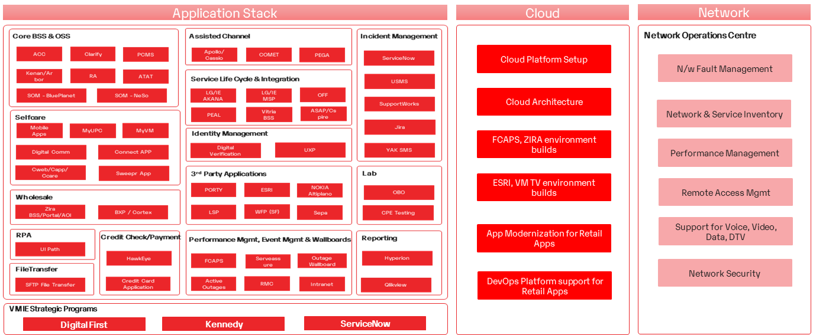
Prodapt has developed subject matter expertise through several strategic initiatives by serving VMIE for the past 4 years
100%
App Knowledge
SME Expertise
in entire Landscape
Cloud Presence
Implementation and ASM Partners
Network Expertise
Proven Industry Solutions
Risk Free Minimal Transition Overhead with No Impact to BAU
Prodapt Presence
New Opportunity

Slide 36


.. And is on the path to addressing the key challenges faced
Multi Vendor Governance
Guardian Role and Standardizing the Operating Level Procedures across Vendors
Our Ways of working
Improving Collaboration through structured Operating Level Agreements, Governance and Gating Mechanisms
Third Party Dependencies on Restoration Time
Shifting Left and Cross Skilling L2 Teams to reduce dependencies on Third Party Vendors
Improving Network Operations
Multiple Areas of Improvement in the current Network Operations
Cyber Security
Bring Cyber Security into One Ops Model

Slide 37
The Results Achieved in VMIE over the last few Quarters
Suseel / Sanjay ; Meyy to help
COMPLETED
IN PROGRESS
IN QUEUE/PLANNED
CSI Areas | Q1’23 | Q2 | Q3 | Q4
Automations (BAU& Kennedy)
Dashboards (BAU& Kennedy)
Reporting /KPI/Business (BAU& Kennedy)
Process Standardization (BAU& Kennedy)
Hourly Order Report – Retail
UiPath Migration - All bots
ITHD: Service Now –Bot integrations
Clarify Order Fallout Fixes - Automation Phase 1
Order Fallout Fixes - Automation Phase 2
15 Minute Order failure report - Comet, Clarify
Hourly Order Status report – Ciena BP- SOM
Bot integrations MS Teams Channel – Order fallout Notifications
Starter Pack Automation – Phase 4 (ACC & Clarify user profile creations)
User Termination process Automation – Phase 5
ITHD: Starter Pack Automation – Phase 3 (Email & Exchange online migration)
ACC Sales ID Reconciliation (TBC)
Graph API integration
Hourly Order Report – Wholesale
Phase 1: Order Monitoring Dashboard-Comet ,Clarify
Phase 2: Order Monitoring – SOM integrations
Phase 3 : Business Dashboard –Order trend analysis
Phase 4 : Order failure trend –Historical view
Phase 2A : Feasibility check for additional Order Monitoring components
Phase 3A : Component based order failure view-Phase 1
Phase 4A : Order Statistics – Wholesale & Retails
EOD Incident Report -retails
EOD Incident Report –Retail & Wholesale
KPI Reporting –Phase 2
: Order failure trend analysis
Daily Health checks Reports
KPI Reporting –Phase 1
KPI Reporting –Phase 3
Daily FCAPS Alarm Reporting
Order Statistics – Wholesale & Retails
Knowledge Library – SOPs, Blue Book (Retail)
Knowledge Library – SOPs, Blue Book (wholesale)
User education- Lessons Learnt
Problem Management -RCA categorization and permanent fix coordination's
DBA Health checks
Wholesale Order Monitoring Review and Fixes
SOP Revision and Ops alignments
DTV Health checks
Problem Management
Incident Process –Phase 2
SOP Revision and Ops alignments
Lessons Learnt - best practices
Lessons Learnt - best practices
Application Health checks – Comet, Clarify,SOM,FCAPS,ESRI,ZIRA,Service Now, SIRO
Incident Process – IT, Network, MIM, Vendors –Phase 1
Quarterly Improvement Review
Monitoring process optimization
Quarterly Improvement Review
Quarterly Improvement Review

Slide 38
Prodapt’s best practice solution for VMIE
Objectives
Solution Themes
Projected Outcomes
01
Integrated Operating model across schedules
Cost savings of X% over 5 years
Productivity improvement of Y% over 5 years
End to end accountability resulting in MTTR improvements by X%
Integrated org structure bringing in innovation and best practices – X ideas per year
Improvement in business KPIs by X %
A
E
Harmonized support across schedules
Drive Efficiency, Effectiveness through Innovation
02
Value Driven Continuous Improvement (VDCI)
A
E
D
E
Reduce TCO
03
Persona based Support Model
B
E
Enable VMIE to focus on its' core business
Measure Performance through dashboards
04
Unified Governance focusing on Innovation
A
E
B
D

Slide 39
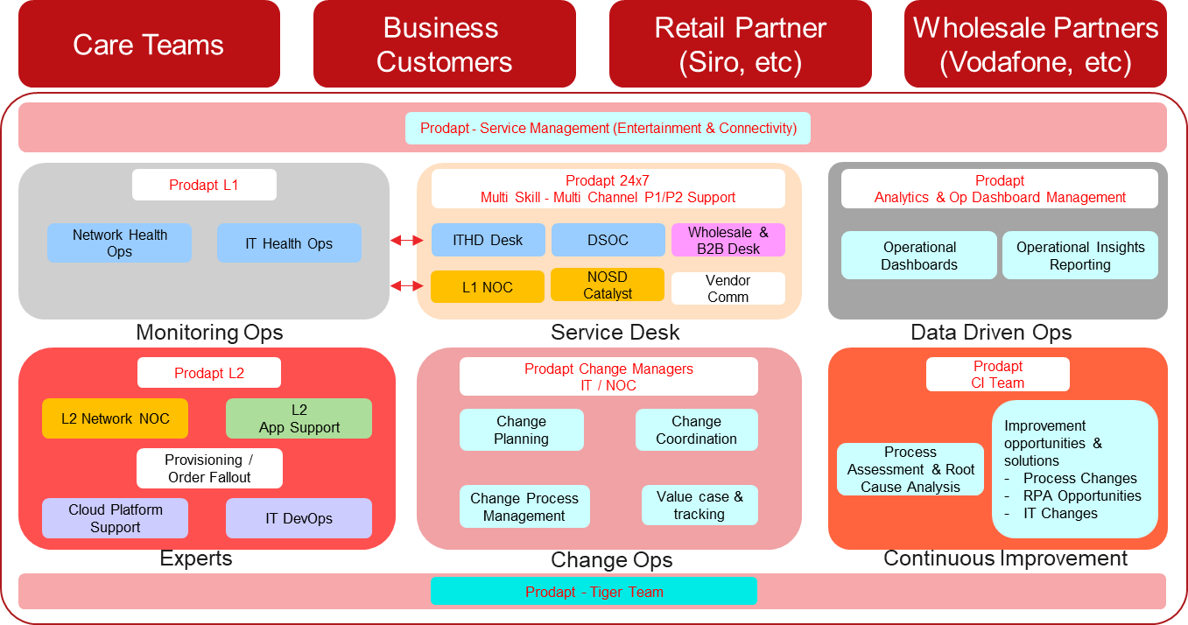
Achieving the Target Operating Model as conceived earlier
01
Scoped Schedules aligned with our TOM framework
Schedule 1
Service Desk & Monitoring
Schedule 2
App Support L2
Schedule 3
B2B Operations
Schedule 4
Network Ops (L1 & L2)
Schedule 5
Cloud Platform
Schedule 6
Service Management & ORM
Schedule 7
Tiger / MIM

Slide 40
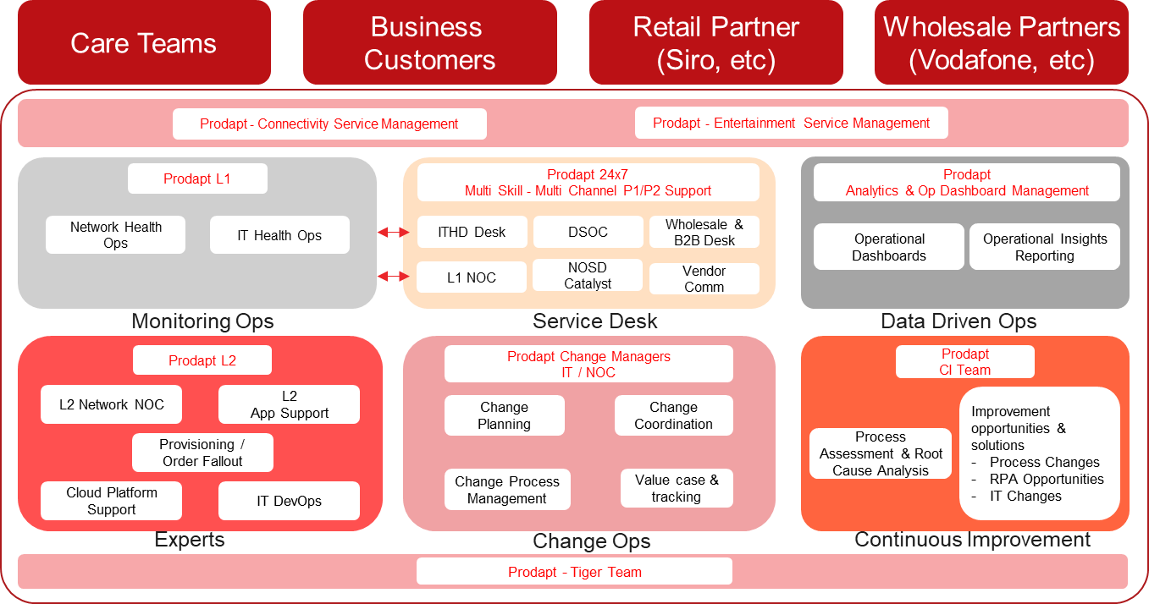
Achieving the Target Operating Model as conceived earlier
01
Benefits
Focus on Service Delivery Excellence through continuous improvement and innovation initiatives
Unified Highly Responsive & Skilled Operations Teams with business aligned front line for faster resolution
Business focused operations to move from IT SLAs to Business KPIs and measure success through NPS
Integrated Governance approach to deliver on commitments

Slide 41
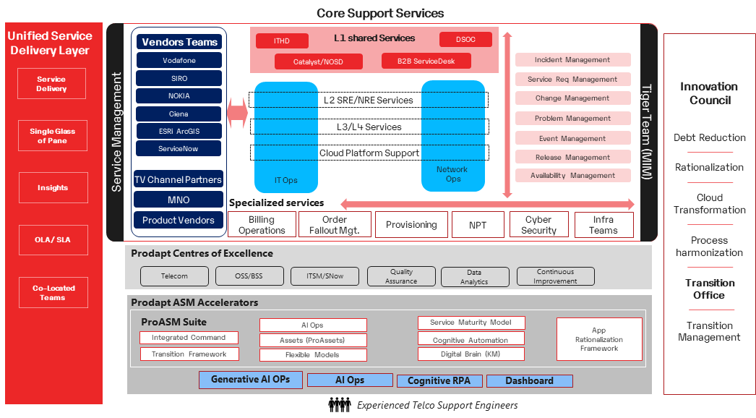
“One Ops” service management operating model
01
Taking VMIE along with our partners on a journey of ..
Reduce Total Cost of Ownership
Improved Customer Experience
Flexible Delivery Model

Slide 42


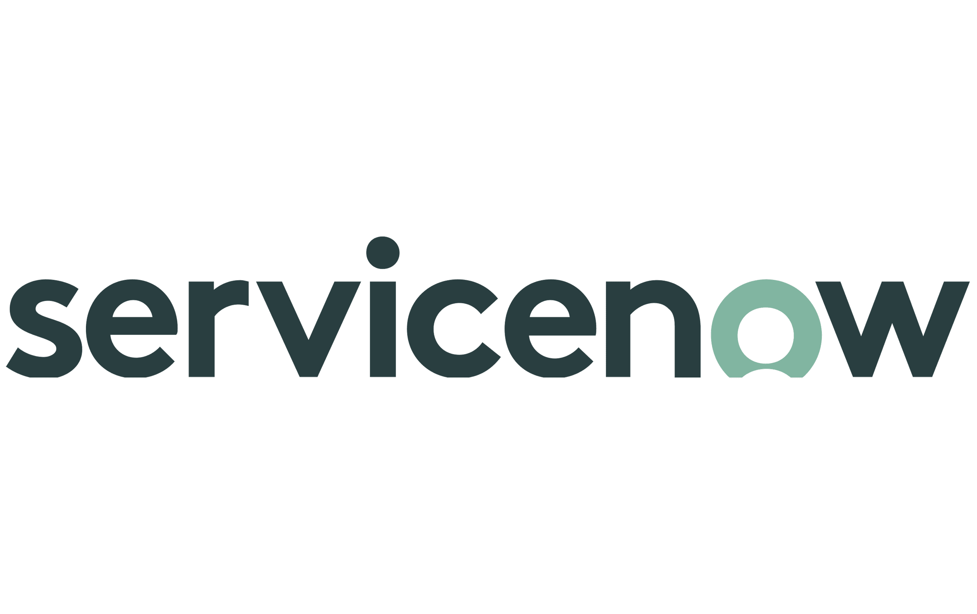

Evidence of improving MTTR through “One Ops” model
01
Problem/Issue reported on DTV Platform – 103+ VMIE End customers reported of “no access to on demand” page on D4A platform
Issue reported on Wednesday 15 February 2023 11:51 AM
Resolved Time: February 17, 2023 5:23:38 AM
1
2
4
7
8
9
Care teams reported the issue
NOSD perf initial check & confirmed issue
ECN Team creates ticket in USMS
IE Access Team
VMIE Tiger Team Involved
ECN RMC Team
CNO Networking
LG CM Team
# of Hops
10+
5
CSD Video
MTTR of P2
>43Hours
IE DTV Platform Team
Request for
Upgrade t o P3 and then P2
Ticket was upgraded to P2
Technical Bridge was created
Management Comms Shared in regular intervals
Validated issue resolution through BV
6
Issue Resolved
# of VMIE End Customers Impacted
103+
3
Challenges
Ticket prioritization not followed properly
Lack of Response from ECN/CSD-Video Team
Day 1 - 15 February 2023
Day 2 - 16 February 2023
Day 3
New world working with Prodapt Teams including NOC
1
2
3
Hops Reduction by
Care team reports the issue
NOSD performs initial check & confirmed issue by working with IE DTV platform Team.
SET Right Priority of Incident
ITHD/DSOC raises ticket in ServicveNow
Involves relevant team in Tech Bridge for resolution
Resolve Issue
70%
Prodapt NOC Ops
CNO Networking / Engg Team
Bring Care/IE business Teams for BV
MTTR Improved by
80%
Involve VMIE Tiger Team
CSD Video
Prodapt PM Team
Accelerators planned
LEFT Shift from NOSD/NC to DSOC
Co-Locations
VMIE User Experience
Prodapt CM Team

Slide 43
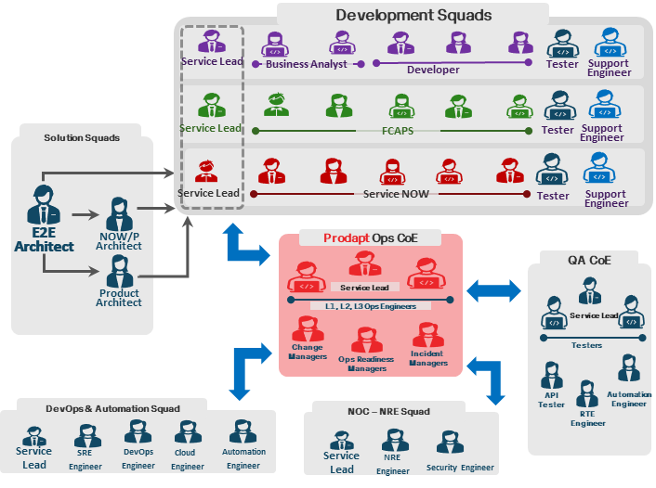
01
Integrating with all other functions with Proper Gating and handovers to ensure a seamless move to production while maintaining Availability and Stability
Key Support levers based on
Threshold Based Gating at each stage
Continuous Feedback Loop for Improvements
Known Issue Documentation & Decisions
Stakeholder Details and OLA/RACI Updates
Hypercare Support Details for Faster Response
Release Specific Documents and Knowledge
Show Stoppers - P1/Defect Volumes
Lean in on …..
Efficient Handovers
Stable Systems
Improved Predictability
Continuous Improvements

Slide 44




Prodapt Network Operations with Continuous Service Improvement
01
Service Desk Support
02
NOC Support Team
Monitor, Acknowledge and Notify incident
24x7 Operation and Maintenance ( as per the scope)
Complete FCAPS functionality
(24x7 – Alarm / Fault/Provisioning / Performance Management) as per scope
User complaint Management
Reporting, Documentation and Process Management
02
01
05
05
Operations Management
03
02
Operations Governance and Support to Delivery Teams
Escalation Management
SLA/SLO Driven
Audit and Reporting
03
Central Support Team
Ongoing Design Support, Configuration Management and Change Management based as per the scope
Software/Hardware Planning and Engineering
Performance and Optimization Management and Reporting
04
03
04
Continuous Improvement
Expedite Time to Repair (TTR) and fault resolution
Automate Proactive and Preventive Operations
Long term sustainable network state
Operation Excellence
Continuous learining and knoledge managemant
Notes:
Kondal

Slide 45




Value-Driven Continuous Improvement (VDCI) function to instill a culture of constant advancement and stay ahead of the competition
02
View of a typical fibre operator’s organization construct with integrated continuous improvement
Strategy, Infrastructure, and Product
Operations
Strategy and commit
Infrastructure lifecycle management
Product lifecycle management
Operations support and readiness
Fulfillment
Assurance
Billing and revenue management
The transformation of cross-functional operations performs 30-40% better than their single-function counterparts.
-McKinsey
VALUE-DRIVEN CONTINUOUS IMPROVEMENT (VDCI) FUNCTION
VDCI function independently interacts with multiple functions in an agile fashion. It fosters gradual process, product, and service upgradation with clearly defined benefits/values and minimal investments/self-funded initiatives enabling a big change.
“Identified Gaps”
Spike in P1/P2 incidents
Repeated ITHD /L2 activities
Perform unified data-driven analysis
Identify opportunities/ gaps
01
Prioritize opportunities
Identify and plan for change initiatives
Categorize solution – people, process, IT
” Prioritized”
Health check Automations, Password Resets, Starter pack Bots
Discovery
Formulation
04
02
“ Result Evaluated ”
200 + Incidents reduced
25+ P1/P2 reductions
850+ ITHD actions by BOT
1600+ Dashboard Alarms
“Automation Executed”
Designed, Developed ,Tested and Deployed the UiPath Bot solution & Health check Dashboards
Monitor pre- and post-implementation results
Value-track change initiatives
Evaluation
Execution
Ensure business readiness
Develop and implement change initiatives
03
Working model of a VDCI function

Slide 46
Embed a Value-Driven Continuous Improvement (VDCI) function into your organization’s structure to instill a culture of constant advancement and stay ahead of the competition - VMIE scenarios
02
Strategy, Infrastructure, and Product
IT & Network Operations
Strategy and commit
Infra lifecycle management
Product lifecycle management
IT & Network Operations support and readiness
Ordering & Fulfillment
Service Assurance
Billing and revenue management
1.Discovery
2.Formulation
3.Execution
4.Evaluation
High Number of P1/P2
Health Check Automations
Dashboard – Health Checks
200+ incidents Reduced
25+ P1/P2 Reduced
1600+ Dashboard Alarms
VALUE-DRIVEN CONTINUOUS IMPROVEMENT (VDCI) FUNCTION – Implemented in VM IE
Repeated Manual Password Resets
Password Resets
RPA Bots – LAN and ACC password resets
90% TAT improved
Zero Error Password Resets
500 + Task executed by Bot
Long employee onboarding process
Starter Pack Automation
RPA Bot for Start Pack – Apollo, LAN, Qfiniti, Finesse
350+ Task executed by Bot
90% TAT improved
Zero Error Password Resets

Slide 47

Resulting in An End To End Commitment on Ticket Reductions and MTTR improvement
02
Improve MTTR
Reduce Ticket Volumes
Innovations
Prevention Focus
Current Activity
MTTR Improvement – Minimize Impact
Incident & Problem Quality Gate
Incident Ageing checkpoints (Minimal)
Ticket Prioritization (More P3 and Less P4)
Improve Incident reporting and reduce incident ageing and hops (Service Now)
Incident Reporting flexibility (Minimal)
RCA and Resolution Audit (Minimal)
Schedule Daily Service Now Reports (Daily)
Incident Quality Review (Weekly)
Ageing Audit(Weekly)
Problem Review - Tracker and Prioritizations (Weekly)
Problem Review (Minimal)
Vendor Problem Review (Minimal)
Monthly Vendor and CARE Connect, User education
Enhance Monitoring/
Automations/Process improvements
SOP based Resolutions (Manual )
No centralized exception monitoring solutions
Automation, Dashboards. CARE consultations, Process standardization
Order Monitoring (20%)
Less CARE interaction on Challenges
Generative AIs /Chat GPT –SOPs, FAQs
E2E order monitoring Dashboards (Retail & Wholesale)
No End-to-End Order monitoring dashboards
Suggest /Improve Exception Logs (Minimal)
Cloud Ops Left shift, Log Automation
Order failure trend analysis (Weekly)
MTTR reduction through more frequent reviews for all the schedules by enabling process standardizations, innovation ideas, automations
which results customer experience enhancements

Slide 48






Executive Summary
Prodapt’s Value Proposition to VM-IE - Flatlined 20% Savings Day 1
Meeting VMIE RFP Requirements
Seamless Transition
Continuous Improvement
Hybrid Efficient Operations
Transparency and accountability
Visibility of every Engineer and their activities
Named Lead resources for well- defined accountability
Experience with VMiE technologies and platforms
Quality talent
Right governance and processes
Deep expertise on NetOps for Telcos & OEMs
Focus on end customer experience
Towards Near-Zero Touch Ops
Predictive and Proactive
From Rule based to Anomaly based
Contingency planning
Leveraging Open-Source Full Stack Observability & Network reliability Engineering tooling
Zero cost 90-day Knowledge Transfer
Y-o-Y efficiency gains for VMIE passed on upfront
10% Buffer for new services ticket support
Right talent
Ability to hire and retain better talent due to our single-minded focus on Telcos
Recent acquisition of Synophic (NOC focused) and AT&T center in Slovakia
Lower cost
Prodapt will absorb Knowledge Transfer cost
Flatline pricing for Savings from Day 1
Existing partner to VM -IE on Video platforms
Visibility of resources and their activities
AIOps to minimize human intervention
Industry partnerships – Cisco, Ciena, Juniper, Arista, AWS, GCP
Efficient operations leading to Tangible cost benefits
Coverage for New Services tickets
No Cost of New Services
No additional cost for New service tickets up to 10% (from year2 onwards)
Running Network Support Center for Large B2B customers from Kosice for 3 years
Managing over 100 B2B customers and 15K sites annually
Managing NOC for countrywide network
IP/MPLS, Packet Core, Security, Gateways
NOC support for 4G/5G Cloud network
Transport, EPC, FemtoCell, network Security
Supporting NOC of major Enterprise customers like HSBC, BoA
NOC operations for 3G/4G (20+ hubs)
IP/MPLS
Notes:
Too texty / less words
Zero cost

Slide 49
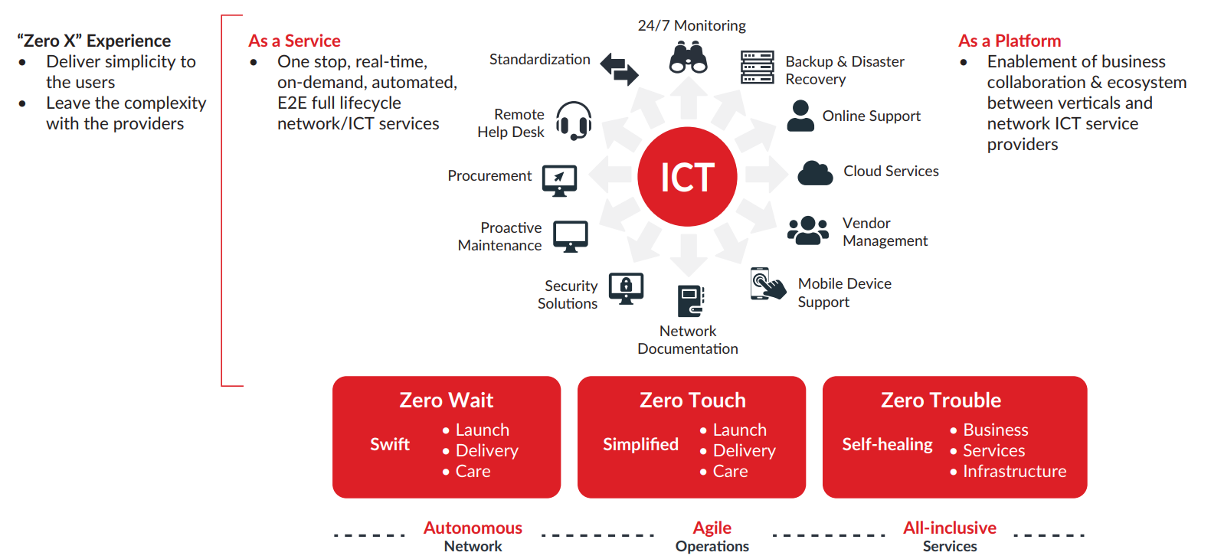
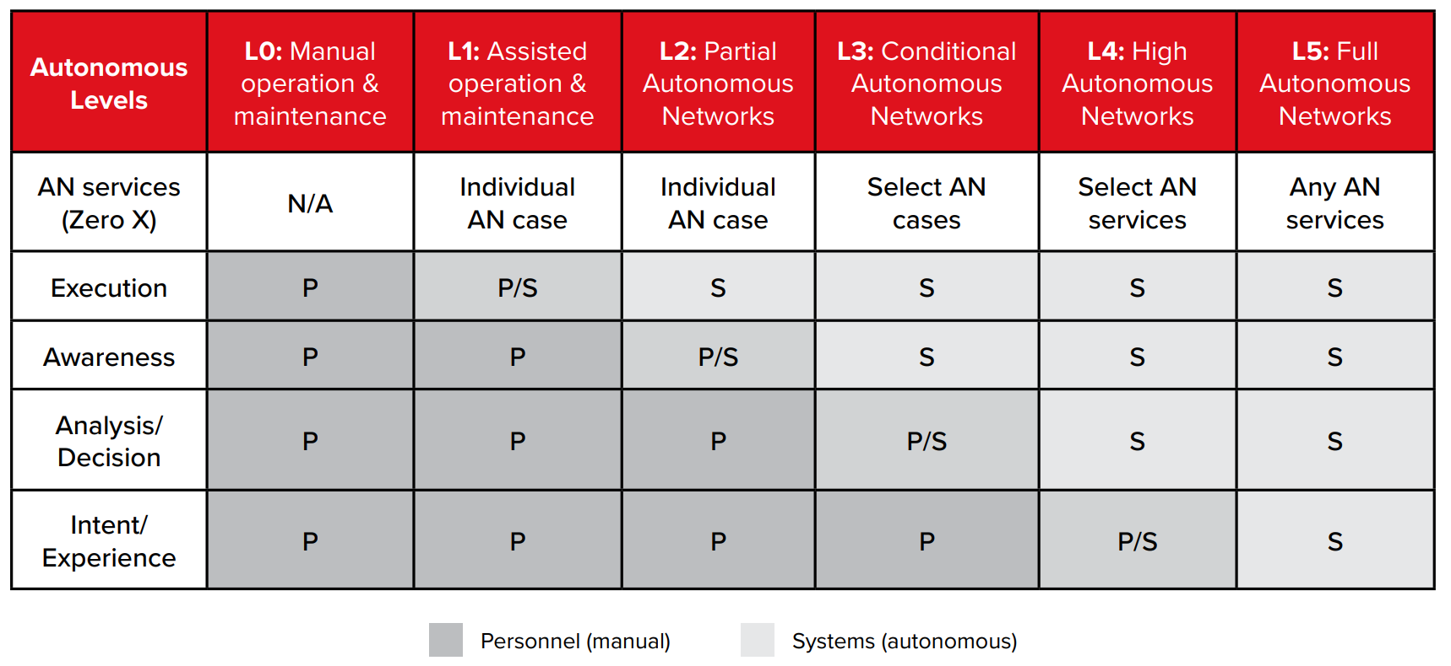
Our Vision for Autonomous Networks at intersection of industry status & standards
As Communication Service Providers (CSP) transform to Digital Service Providers (DSP), they shift is from
‘Infrastructure (Network, IT) Centric’ → “Services Centric” → Experiences
Industry 4.0, 5.0 .... X.0 Use cases
Target State
Evolution to L4, 5 in 3 Years
Current State, Legacy Services
Access – Fixed, Mobile
Core – Mobile, IMS
Network
Data Center Infra
Availability, Evolution of Systems, Process transformation, AI Driven / AI Assisted, Policy / Anomaly,
Automation, Domain specific implementations, Release Management all are a part of …
Key business drivers for transformation initiatives
Reduce time to market for new products, services
Predict & Mitigate issues before they happen
Standards Reference : TmForum, ZSM

Slide 50



Reference Tier 1 Telco Scenario - Improved NOC Productivity through Automated Correlation & Remediation
Alarm Source
Alarm Handling
Automation
Manual Acknowledge
Engineers can handle 100% more alarms with Automation
Service Now
View Details
Alarm Merging
Acknowledge
View Details
Less Manual work & L3 Escalations
Correlation Analysis
Collect Fault
Diagnosis
Grafana
APPs Alarms
Diagnosis
Rectify
10% Duplicate Alarms
15% Repeated Alarms
15% Correlated Alarms
Alarm Hold & Cache
Rectify
Clear Alarms
Alarm Marking
Clear Alarms
Change Requests
Alarm Type | % Alarm | Year 0 | Year 1 | Year 2 | Year 3
 |  | 128009 | 185613 | 243217 | 300821
Duplicate | 10% | 12801 | 18561 | 24322 | 30082
Repeated Alarms | 15% | 19201 | 27842 | 36483 | 45123
Correlated alarms | 15% | 19201 | 27842 | 36483 | 45123
Alarms Per Day |  | 210 | 305 | 400 | 495
Alarms Handled per Engineer per shift |  | 11 | 16 | 21 | 26
Fetch
Alarms
Diagnosis
&
Assign
Auto Fix
Known
Issues
Close
Ticket
*Conservative numbers

Slide 51

NetBots.AI : Intelligent Network Operations, Provisioning, Planning Automation
NetBots.AI – Applicability
Service
Delivery
Network Operations
& Assurance
Network
Planning & Access
Management
are set of network microservices that does the heavy lifting of the repetitive NetOps tasks, and improve the efficiency of the network engineers, when scaled with a unified user GUI interface and customizable bots catalogue.
Network tasks coverages
Order Management
Provisioning & Service Activation
Test & Acceptance
Zero Touch Provisioning (ZTP) in DCs/sites/COs
Network health check
System validation
Network tasks coverages
NoC repetitive tasks
Alarm and Fault monitoring & suppression
Alarm Correlations
Security Threats Mgmt.
Network Turnups/ Decommission
Configuration backups
Network tasks coverages
Network Utilization
KPI Calculator
Fault Diagnosis
Root Cause Analysis
Demand management
Site engineering, and analysis
Savings
Rapid Network Diagnostics
Post Launch Health Checks Times
Spine & Leaf
ZTP (RPHY)
45%
37.5%
40%
Top Realized Benefits
Automation & Predictive Analytics
Utilizations check & Predication (CDN/NW)
Network Fault/ evet prediction
NPD truck
reduction
80%
40%
NetBots – Plan & Build Assembly line
Build
Identify/Req.
Define
Design
UAT
Deploy
Test

Slide 52












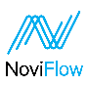


Key business benefits realized across network operations, provisioning, and planning automation
1
Open-Sourced Automation for CAPEX & OPEX Savings
Fast-tracked Automation & predictive analytics
5
2
Rapid OTT SD-WAN activation by 45%
6
Efficient Utilization Analysis & prediction
A set of network microservices that does the heavy lifting of the repetitive NetOps tasks, and improves the efficiency of the network engineers, when scaled with a unified user GUI interface and customizable bots' catalog
3
Improved post launch health check time by 37.5%
Improved network fault event prediction by 80%
7
4
Improved Spine & Leaf ZTP (RPHY) by 40%
NPD Truck Roll
reduction 40%
8
Top Realized Benefits
Top Partners
Top Telco SI Partner
Monetizing the edge, Modernize Core Systems, Network Evolution & Digital Experience

Slide 53
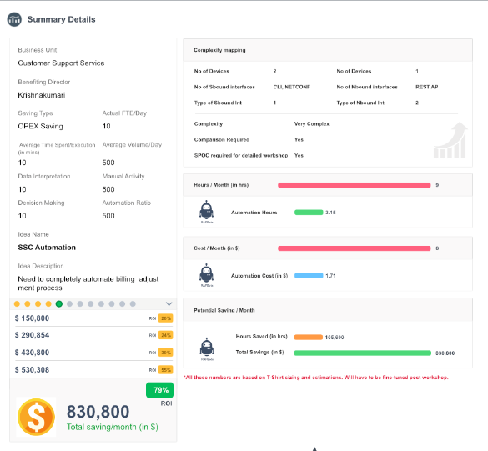
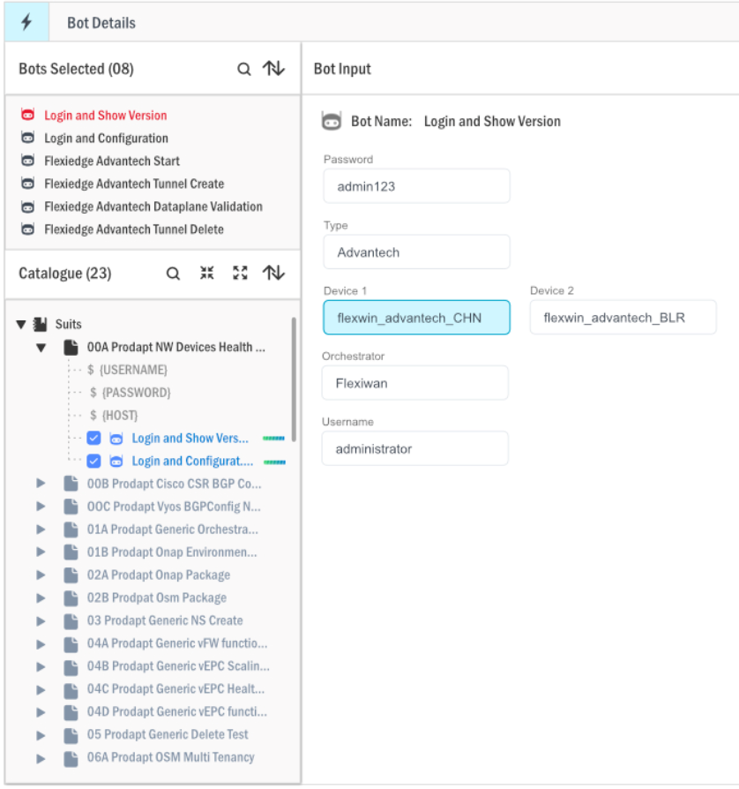
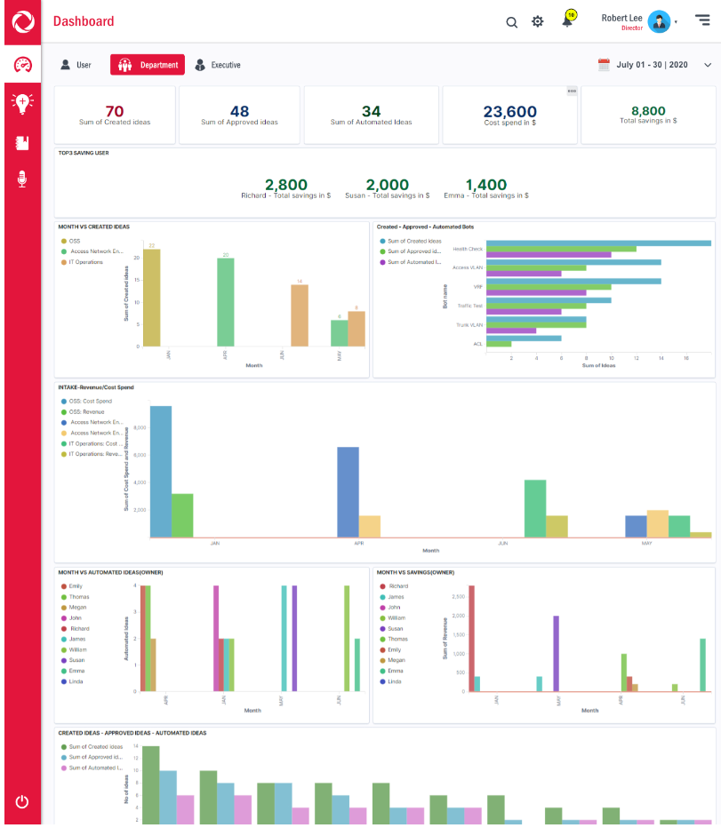
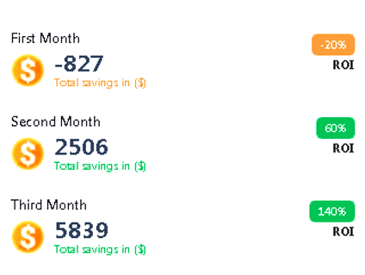
NetBots Automation Journey: Ideate, Develop, Run, Track Automation Ideation Intake; Bot Runs; Exec Automation Success KPI Tracker
Automation Ideation Intake
Automation Catalog/ Bot Journey
Automation ROI/KPI Exec Dashboard
Automation Ideation Intake Benefits Summary
Minimum acceptable rate of return
Post Approval/ Bot Dev/ Bot Catalog / Bot Run
Bot Reporting
Executive Dashboard – KPI Tracker
Dashboard – KPI/ ROI/Success Tracker
Exec/Dept. Head/User

Slide 54
Potential Incident Handling Call Flow Automation Opportunities
v
Phase 2 Automation
Phase 3
Automation can be integration of events and ticketing tool
No
To Problem Management
Check Runbook
Check runbook status, if yes go to problem solved
v
Correlation and categorization engine to be introduced?
Phase 1 Automation
No
No
Follow notification policy
Manual Process
Alert Reference?
Yes
Correction Policies applied
Categorization Policies applied?
Escalation Rules defined?
Yes
NOC Performance initial troubleshooting
Create common troubleshooting bridge
Yes
No
Involve Change Management
NOC responsibility starts once they are noted by agreed method SNMP/SMS/Call/Email
No
Incident Received
Genuine Alert ?
Categorization Done
Auto close polices applied
Alert Notification reference done
Initial notification sent
Incident logging/Categorization/ Prioritization
Problem Solved ?
Resolution needs Change ?
Initial diagnosis for agreed time by L1 team
Yes
No
Apply and close the services
Yes
Direct Solution?
No
Log and request Runbook
Involve Problem Management
Phase 1 Automation
Tools : Pagerduty
1.Automation Notification
2.Automation Escalation
3.Bulk Notification
Notification Policy Defined?
Phase 2 Automation
Report & Analysis
Send reports daily/weekly/Monthly
Customer Reports
Send Automated Reports

Slide 55
Example of NOC Automation Cases with Prodapt NetBots.AI
Total Use case - ~ 150
DOCSIS Upstream Combiner Service Impairment Detection – Productization
Common Cloud Systems/ IP NW Configuration and service management
IP NW - 60 ATP and i-ATP test cases
Common Cloud Systems & IP NW - Zero touch provisioning scenario.
Zero Touch Provisioning (SDE/RCMIN)
Interface Troubleshooting Closed Loop
Links Turn up(IP-Core/SDE/RCMIN)
NOC & Ops - IP Address Management for each service +2
6 device software upgrade and for 3 vendors
IR21 Roaming Request
GPON
Roaming Partners APN Use Case
Firewall Change Request
RPHY
IGW Transit Peering
Wireless access operations – Crash Audits + 26
Microwave - Automating cli/Telnet configuration on minilink TN + 3
BGP configuration and Pre-Post Checks
Pre/Post Checks for Network Devices (IP-Core/SDE/RCMIN/REN)
NCT Ticket creation and Spatial Update
Automation of EPL Service Regression Testing + 8
Operations, Voice, Data - Automate MMSC daily alarm task + 13
Reading Config from Devices +7
HFC Ops - Tier 2 tool result extraction + 9
Core IP - CMTS Interfaces & Configuration Management
Transport - Pull together a connection matrix connected to my device ports and Wavelength
Network Planning, Maintenance – Automatic Report Creation
Radio Access TAC - Crash files correlation within devices
Net Dev, Core & Video
Access Network PMO

Slide 56
Use Case1 - Testing & Diagnostic Use Cases for Tier-1 NA FMC Provider
List of BOTS Suits developed for use cases
TWAMP | UMTS-MSC-SIZE-ALT | EON-ISIS
LTE-Service-Degraded | RHP-C20-XPKT300 | peakflowSPTraps
XRE-Error | TLAN-Site-Commercial-Power-Failure | Power-Supply-Generic
SGSN | SIR-SANDVINE-Threshold-Failure | RCBIN-BGP-Neighbor-Loss
NNMI-Atria-Not-Reachable | NNMI-Black-Node-Down | RCBIN-Link-Down
NodeB-Service-Outage | RCWIN-Core-Unreachable | RCBIN-Neighbor-Loss
MMSC-Alarms | EON-Link-Down | RCBIN-Core-OSPF-Neighbor-State
LTE-RET-Failure | RCMIN-Core-Not-Reachable | RCWIN-Redundancy
Ericsson-LTE-Linearization-Disturbance-Performance-Degraded | Splunk-IPTV-Tune-Failure | ISMSC-Connection-Has-Been-Terminated
UMTS-Antenna-System-Problem | Casa-UPS-Switch-Over | LTE-HLR-UA-DESTINATION-INACCESSIBLE
Ericsson-Generic-With-No-Cell-Status | NNMI-RCWIN-Node-Down | RHP-G6-Alarms
Ericsson-Generic-With-Cell-Status | CGN-CPU-Monitoring | RHP-Trunk-Group-Alarm-C20
Ericsson-LTE-CellKPI-Downtime-Manual | CGN-Memory-Monitoring | UMTS-MSC-UA-Destination-Inaccessible
Ericsson-LTE-CellKPI-Downtime-Automatic | SBC-Session-Agent-Status-Change | CH3000-Power-Supply
Ericsson-LTE-Service-Outage | SBC-Redundancy-Alarms | MW-MiniLink-Service-Degraded
LTE-Resource-Activation-Timeout | MME-Alarm | RFGW10-Default
LTE-Resource-Activation-Timeout-Service-Degraded | CUDB-Alarms | RFGW10-Neighbor
IPRAN-Link-Down-Major | MW-Ceragon | RFGW10-FRU-and-Module
LTE-Resource-Configuration-Failure | REN-Core-Link-Down-Major | RFGW10-Warmstart-and-Coldstart
LTE-PLMN-Service-Unavailable | Ren-Core-Neighbor | RCDIN-Core-OSPF
Ericsson-LTE-Link-Degraded | IPRAN-NNMi-KPI-Interface-Alarming | FastBack-MW-Radio-Link-Down
Diagnostic-Ericsson-LTE-Service-Degraded | IPRAN-BGP-Peer-Connection-Idle | QPSK-Not-Reachable
LTE-Ericsson-No-Connection | SBC-RHP-Alarms | RFGW10-ceRedun-EventSwitchover-and-Status-Change
BSC-Heartbeat-Failure | IPRAN-MPLSLDP-Session-Down | NodeB-Service-Degraded
LTE-Ericsson-VSWR-Service-Degraded | RHP-C20-GWCA-306 | OTDR-Go360-Web-Trace
IPRAN-OSPF-Neighbor-Down | OS32-Switch-Status-Reading | Ciena-6500-Transport-Node-Alarm-Verification
UMTS-RNC-Alarms | LTE-HLR-Heartbeat-Failure | Minilink-License-Alarm
UMTS-MGW-Alarms | UMTS-MSC-Switching-Network-Terminal-Fault | GQAM-Reset
RCMIN-Core-OSPF | UMTS-MSC-Blocking-Supervision | CS2K-IGW-Trunk-Alarms
TLAN-Generator-Run | EON-Reachability-Problem | Generic-Microwave-Minilink
TLAN-Rectifier | Arbor-Alarm | Service Impairment Detection
TLAN-Temperature | AD-for-EON-PChip-Error | APN
TLAN-Tower-Light | Atria-Cold-Start | Service Impairment Detection
TLAN-Wide-Bank | CASA-Generic-Link-Status | Service Impairment Detection
TLAN-Integrated | CASA-MPLS | UMTS-MSC-UA-Destination-Inaccessible-Bell-Mobility-BICC
RHP-911-TGA-C20 | CASA-OSPF | EON-7360-PON-OLT-LOS
RHP-C20-System-Busy | CASA-SMM-Switchover
Test Case Category
Diagnostic Automation
Alarm Management
Test Cases Automation
Configuration Automation
O&M In POD NW
Alarm
Device Up/Dn-grade/
Device O&M
PMI
LINK O&M
Fault
Monitoring In POD NW
Performance Monitoring
Terminal Monitoring

Slide 57
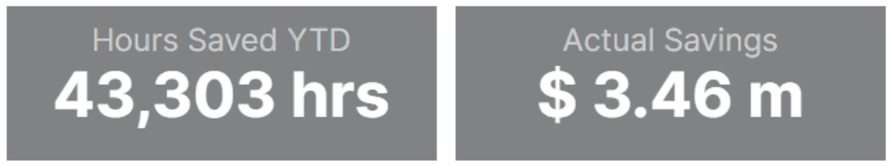

Diagnostics Use Case #1 ……
Use Case Description
Diagnostic verification for multiple types of devices involving CISCO, JUNIPER, ALU, HP, ERICSSON and many others.
Based on the Alarm in Monitoring tool, Netbots will run corresponding Diagnostic commands and collect the stats and status
Benefits
Solution Approach
Once the Alarm is received in Monitoring tool (NetCool), Broker(ESAP) will raise a Remedy Ticket based on pre-defined rules.
Netbots will receive the Alarm details including device IP, Remedy Ticket Number and run the pre-defined diagnostic commands based on the device types.
The diagnostic command outputs are prepared in a structured format in a HTML file.
HTML formatted Outputs are then appended back to the Remedy Ticket, also capturing the current state of Alarm.
Workflow Diagram
REST API
NETCOOL
ESAP
Remedy
REST
REST
SNMP
NetBots.AI
CLI / NETCONT / REST API
NETWORK ELEMENTS/EMS

Slide 58
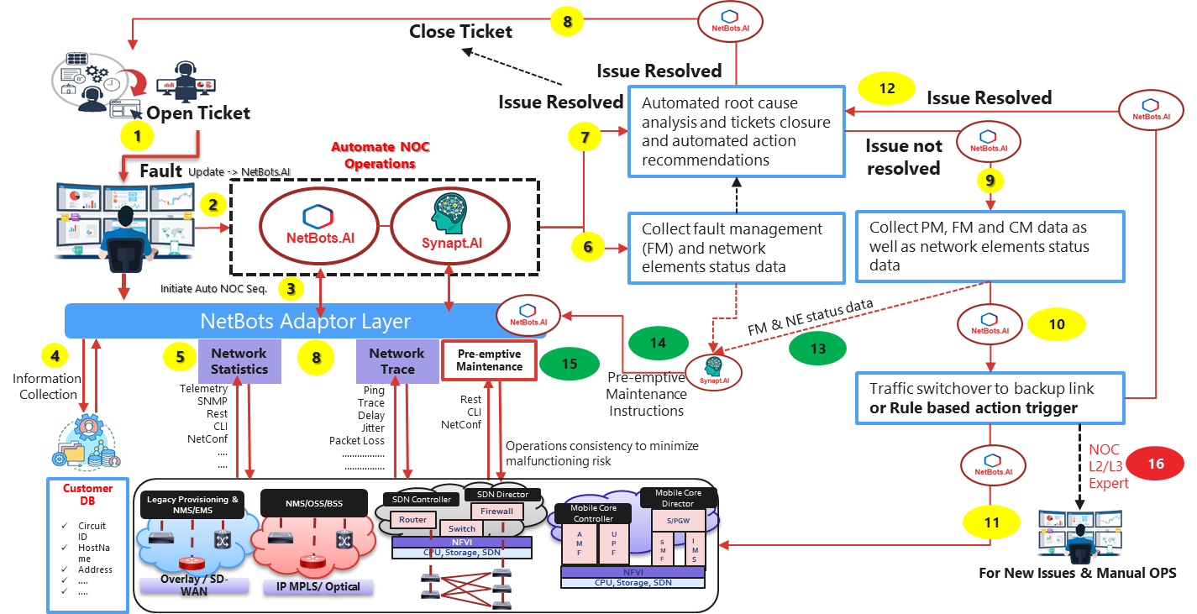
Automated End-to-end workflow for Day-to-day operations
Troubleshoot accuracy
Service Improvement
Faster issue resolution
Auto Repair
Autonomous corrections
Time to resolve
Team efficiency
Escalation's reduction
NOC Automation
Higher efficiency
Human error minimization
Maximized QoE
Constant fix of network
Improved QoE
Predictive Maintenance
Operations consistency
Minimize failure risk
Ticket Opened by Front Office
Ticket is sent to Automated NOC Operations framework
Netbots connect to NetBot Adaptor layer.
Bots from the catalogue collect information from the Database
Bots collect Network statistics from Network elements and applications
Complete Data stat is collected and analysed on AI/ML Platform.
Automated RCA is done and automated actions recommended
If Issue is resolved Ticket is closed.
If Issue is not resolved, Netbots collect all PM, FM and CM data as well as status data.
As per business intelligence decision taken by AI/ML platform, traffic switchover to backup link or Rule based action triggered
Action taken by Netbot
Check if issue resolved and close the ticket
FM & NE status data collected.
Pre-emptive maintenance instructions
Pre-emptive action taken
If issue still not resolved sent to L2/L3 experts

Slide 59

Resulting in An End To End Commitment on Ticket Reductions and MTTR improvement
Existing scenario
Problem Statement: Nokia AMS Server critical warning experienced high TAT due to lack of SOPs and it required over ~22 manual log executions.
Alarm Cleared
Challenges
12+ Various Log requested by Nokia
10 + Command executions Request
Transactions: Config Log,Firewall logs,Site name, OS logs, Ping Commands executions, Disc space logs
# of Hops
22+
7-23
MTTR
>10 Days
FCAPS – AMS Alarm
DSOC
Reported Nokia AMS Critical Alarm , L2 & Tiger involved
2
# Manual Logs generated
1
Service Now
Nokia
VMIE Access Engineering
VMIE Platform /Infra Support
22+
Generative AI Solution
3
6
Knowledge Gap
22 Manual activities performed by Platform
10+ Hours
4
# Manual Effort Spent
5
Alarm Cleared
# of Hops
4
SOP Generation (GPT 3)
4
MTTR
~3 Hrs
2
Left Shift from Platform to DSOC
FCAPS – AMS Alarm
1
DSOC & L2
Service Now
Nokia
# Manual interventions
0
Incident based Log Creation (GPT 3)
3
Generative AI based log creation – All log information attached during ticket creations
Zero dependency with Platform team
Code API- Analyze, Error Logs detections, Share log, Monitor Alarms(GPT 3)
# Manual Effort Spent
< 15 Mins
Incident , Problem Creations (GPT3)
MTTR improvements by left shifting to Generative AI based process automations and GPT3-based SOP routines.

Slide 60


Service Delivery Excellence with AI-driven Predictive Analysis to prevent Incidents from happening
Collected Alarm with Time Stamp
Alarm Processing
Alarm History
Create Time based Alarm Predictive Modeling
Alarm DB
Create Detail Alarm Catalog
Update
DB
Alarm Source
Retrieve Related Alarms
Create Predictive Labeling
Type/App / Features
Alarm Categorization
Update NOC
Take
Preventive
Action
Visual & Prioritized Monitoring
Basic alarm monitoring
Manual fault and performance monitoring
Issue Isolation
Proactive
Statistical Learning
Rule based management & correlation
Reactive Monitoring
Reactive root cause analysis
Manual service & application mapping
TOPN Monitoring
Just in Time
Threshold Analysis for trend & Impact
Action recommendation
Prediction
Learn behavior
Create application specific trend
Application aware KPI, KQI analysis & Mapping
Self Healing
AIML based closed loop assurance

Slide 61




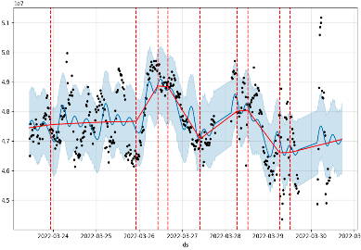











Example of AIOps implementation to prevent Incidents from happening on applications and infrastructure
Applications
AIOps platform
Order management
Cart
Support
Credit check
Cloud
Forecasting/ anomaly detection
Rules engine & event/ alert management
Database
Application servers
Golden gate
IT Operations Management (ITOM) tool
Events | Actionable insights
DB performance anomaly | Pin execution plan, Kill rogue query, Run SQL tuning advisor
GG Abend/Delay | Golden Gate Process Bounce
JVM Health Issues, Service Pod Missing | BounceAppTier
Cert Expiring | Renew Certificate
File system nearly full | Clean file system
Raw data
Prediction & correlation
Raw data
ML model
Insights
Anomalies
Monitoring tools
APM
(Introscope, Glowroot, Dynatrace, AppDynamics)
Metrics
Events
Detects anomalies & triggers workflow
Anomaly detection
False positives
Dynamic thresholding
Database
(Oracle-OEM)
(Casandra – Prometheus)
Tool “Alerts”
Example:
Raw data
ML model to forecast time series data
(E.g., Prophet, Nelson, Arisma, Random Forest, etc.)
Platform
(Nagios | SiteScope | Azure)
IT Alerts
(Netcool)
AIOps event hub
Raw data
Level 3: Automation
Level 2: Recommendations
Level 1: Alerts & dashboard
Pull insights from AIOps event hub
Logs
(ELK| Filebeat | SPLUNK)
Listener provides step-by-step guide to remediate
Email
Microsoft Teams
Auto-remediations
Notifications
Automated scripts to enable auto-remediation
Remediation guide
(Prescriptive)
Alert listener
(NodeJS/ Java/ Python)

Slide 62












04
Unified Governance
Challenges
VMIE CTIO Office
Benefits
VMIE Operations Leadership
Perception Management
Relationship Management
Metrics based management
Innovation based management
Generative AIs
Technology Tomorrow
Ideation exchanges
OLAs with 3rd Parties
Forums and interactions with the 3rd parties
Interactions between Prodapt Teams
Engagement with 3rd Parties
Void of 3rd parties unification
Missing e2e ownership
Overall 1 Prodapt
VMIE Business Operations
VMIE IT Management
Network & Security Management
Dashboards & Portals
Metrics based management
Service Governance
Tiger Teams
ITIL Functions
ORM
L1
L2
B2B
NOC
Cloud Platform Support
Operation Level Agreements
Relationships
Vendor Teams

Slide 63
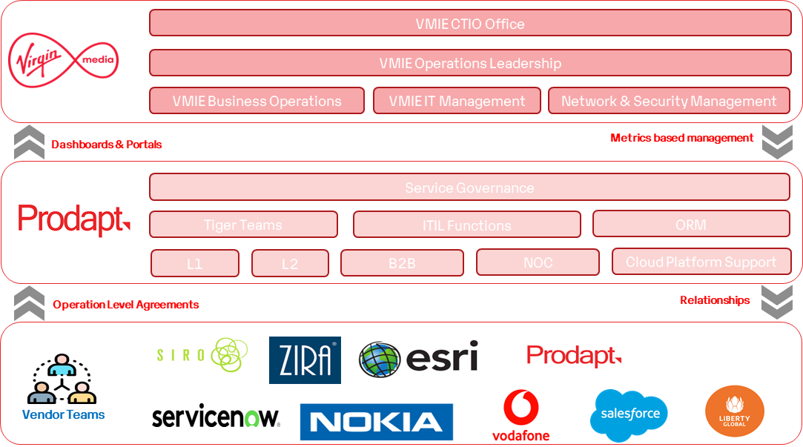
Stakeholder engagements & communications
04
Ceremonies
 | Weekly | Monthly | Quarterly
Ceremony Name | Weekly Governance Meting | Monthly Management Review | Quarterly Senior Management Review (QBR)
Participants | Service Delivery Managers, Transformation Leads, Process owners | Service Manager, Service Director, Project Leads /owners, Vendor Teams | Executive leadership – VMIE & Prodapt Client Partners, Vendor Teams
Reports/ Measurements shared | Metrics based measurements Dynamic reports CSI Initiatives Tracking ROI – Accelerators, Automation & Reuse Weekly OLA and Dependency Reviews | SLA / OLA and Service Reviews Innovation Council – CSI Industry Leading Practices Best Practices / Learnings and Risk Management | Executive Business Reviews Service improvements Problem Management Status Business Value Adds Operations efficiency
Daily Ops Reports
Weekly
Monthly
Quarterly
Monthly
Quarterly
Powered By Automated Operational Dashboards, Daily/Weekly Management Dashboards and Automated Reports

Slide 64
NOC Services provided by Prodapt as per RFP ask
L1 (24*7)
NOC Monitoring
Monitoring
Event Management
Incident Management & Reviews
12 X 6 X 365 (7am – 7pm) + outside of core hours on-call support 24 x 7 x 365
Video
IP & Optical
DTV
Voice + BSB
Problem Management
Change Management
Incident Reviews
Risk Management
Maintenance
Savings will be realized by Smart Automation during the Continuous Improvement phase

Slide 65

Resulting in Harmonized team set-up and incident management flow
IT Operations
Network Ops
Cloud Platform/ IE Provisioning/NPT/LG-Central/ 3rd Party
Shared Desk
Helpdesk / Level 1
L2 App Supp - SRE
Level 3/4Team
Level 2 NOC - NRE
Level 3 NRE SME’s
Cloud/IE Prov/LG/NPT
3rd Party
Major Incident Management Team
Tickets Or SD Create Ticket
Ticket Assigned to Level 2 Teams
Ticket Assigned to Level 3 Teams
Ticket Assigned to Cyber Security Team
Open Tech Bridge / Set Up War Room
Monitoring Apps
Ticket Assigned to Level 3 Teams
Ticket Assigned to NOC Supp Team
Ticket Assigned to Level 3 Teams
N/w Traps/Alerts
Auto-Ticket
Ticket analysis
End Users
Send Mgmt Comms /
SRM module to report ticket
Care Agents
Known problem
Perform code analysis and resolve
Perform analysis
Perform code analysis and resolve
Perform analysis
Perform code analysis and resolve
Issue Resolved ?
Validate False Traps/Alarms
Knowledge Base
Runbook based Resolution
Open Problem Ticket
Ack & Respond
Issue Resolved ?
Runbook based Resolution
Issue Resolved ?
Runbook based Resolution
Issue Resolved ?
Perform Triage
Restored?
No
Is P1/P2?
Yes
Yes
Yes
Problem Management Team
No
SOP/Runbook based Resolution
Issue Resolved ?
Issue Resolved ?
Yes
Service Management Team
Yes
Set ticket in resolved state and communicate
No
Assign Problem Tickets
Restored?
Drive Root cause analysis & Fix
Yes
No
High Sev. Or repeat incident?
High Sev. Or repeat incident?
High Sev. Or repeat incident?
No
IT Issue
Repeat Incident
Yes
Repeat Incident
Yes
Repeat Incident
Code Change?
Assign IT, N/w & Security, Cloud Tickets respectively
N/w & Security
Issue
Yes
Cloud/IE Provisioning/ LG/NPT Team
Change & Release Management Teams
Resolve incidents
3rd Party Issue
Assign to Change management
P1/P2 Incident
Validate resolution
Plan production Deployment
Close ticket

Slide 66





Prodapt Team Structure
04
02
Mohammed Imran
Service Director
Suseel Vadakkepat
Solutions Specialist
01
Ashish Kumar Pandit
Offshore PM – Kennedy Stack
Sathya P
Offshore PM – Legacy Stack
Jobin Alex
Tiger Team lead
Joshua
Monitoring Lead
Aravindh Rahuk
ITHD Lead
Aneesh Sreedharan
Cloud Platform Lead
Sanjay P
NRE Lead
Vishnu Priya
Problem Manager
Prasad Shankar Lohar
RPA/Automation SME
Nkuntima
B2B Service Desk Lead
Priya Muthu
NOSD lead
Bala S
Cloud Managed Services
Rohith M
Change Manager
Arul
Data Analysis Engineer
Thivagar
NOKIA - SME
Soundarya
ESRI SME
Gopu R
SOM SME
Kiran
Salesforce - SME
Dhartini
ServiceNow SME
Rucha
FCAPS SME
Technical delivery, Monitoring & continuous service improvement
Prodapt Core Delivery Team
ITIL coordinators
Client Engagement Team
03
Delivery Leadership Team
Consulting Team
Sriram SS
Eswaramoorthy L
Naresh Govindarajan
Client Partner
Alex Keating
Account Manager
Roshan Mehaboob
Mandeep K
Consulting - Director
Escalation Path

Slide 67








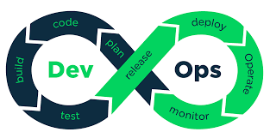
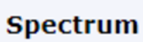



SMEs in the system / Staffing plan
Suseel / Imran
120 + Knowledge Transfer Sessions
98% SME Retention
40 + Operational Readiness
20+ SMEs
SME Towers
SME functions
Service Desk/ Monitoring SMEs
L2– BAU Apps
Smart Monitoring & Triaging
High Troubleshooting skills
Knowledge Book
SOPs
B2B Wi-fi SEMs
L2 - Kennedy Apps
NOKIA
ESRI
Salesforce
Service Now
SOM / Ciena
FCAPS
Good track of ITIL process & SLA Adherance
Highly Align with new Business & Technologies
ITIL Process
Cloud & Platform SMEs
L3/L4 Capability – Service Now, SOM, FCAPS
Continuous Improvements
Knowledge Management
Operational Readiness Check lists
Network Operations SMEs
High availability
Shift Roaster based
Curated Training Programs
VM IE Process
Tiger SMEs
Leadership
Consulting for Critical issues

Slide 68
SMEs in the system / Staffing plan
Suseel / Imran
Knowledge Management has to be embedded
Shift Roaster
Trainings
Team retentions
L3/L4, Service Now capability
120 + Knowledge Transfer Sessions
98% SME Retention
40 + Operational Readiness
20+ SMEs
Service Desk
{Arul Mozhi Varman}
BAU App Support
{ Shruthi }
Kennedy App Support
FCAPS {Rucha}
NOKIA {Thivagar}
ESRI {Soundarya S}
SERVICE NOW {Darthini M}
SALES FORCE - {Kiran}
SOM -CIENA {Gopu R}
NOC/CATALYST
TIGER (MIM)
{Jobin Alex}
Platfrom
B2B Support
{Nkuntima}
{Priya M}
{Bala S}
{Joshua Hayes}
{Hephzibah}

Slide 69





Scope of work
Suseel / Imran
Key Activities
Support Windows
Technology Skills
Schedule 1
Service Desk & Monitoring
L1
Incident Logging, Monitoring ( IT & Network),
Reporting, Vendor engagements & CSI.
DSOC: 7AM – 10 PM (Mon-Sun)
Monitoring : 24x7x365
Schedule 2
App Support
Triaging, SMEs activities, Reporting, Automations, Knowledge Books update and Review.
7AM – 10 PM (Mon –Sat)
On-call :- 24x7 for P1 & P2
FCAPS
L2
Schedule 3
B2B Operations
B2B Support – Out of Hour support, Wi-Fi 1st line ,
Wi-Fi 2nd Line , CSI –Automations
L1
24 x 7 x 365 days
L2
Schedule 4
Network Operations
Network Support, Catalyst/NOSD- VOIP, Optical
and DTV domains - Voice, Optical TV
L1: 24 X 7 X 365
L2 :7AM-7PM(Mon –Fri).
Oncall-24x7
L1
L2
Schedule 5
Cloud Platform
Cloud operations Support - Setup & Manage Cloud platform (GCP & AWS), Devops
0900 – 1730
On call - 24 x 7 x 365
L2
Schedule 6
Service Management & ORM
Service Governance, Operational readiness, Change
,Problem Management, CSIs
0800 – 1730 (Mon –Fri)
Schedule 7
Tiger / MIM
Manage P1/P2 for IT ,Network and Security incidents, Coordination, Communications
08 AM- 1730 (Mon –Fr
On Call :24x7x365 ( P1 & P2)

Slide 70

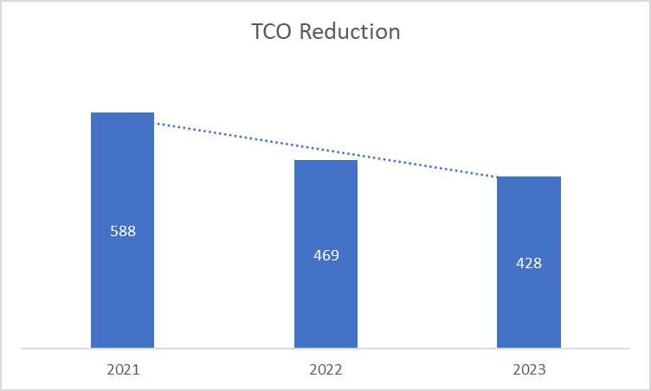
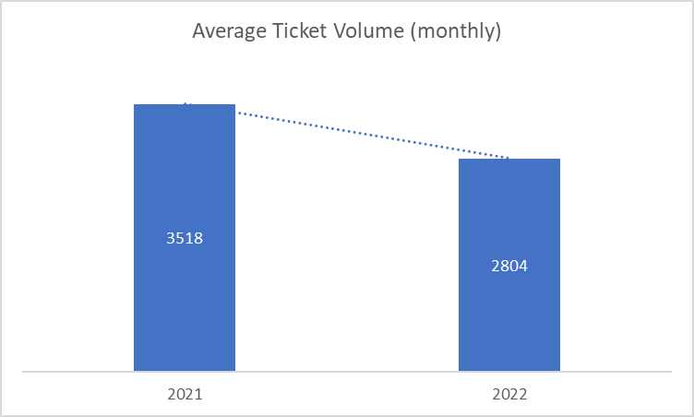
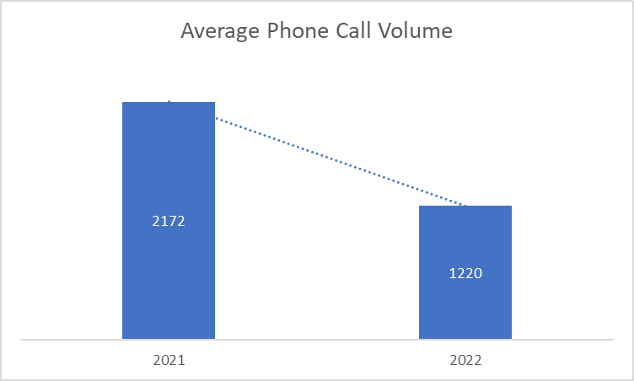
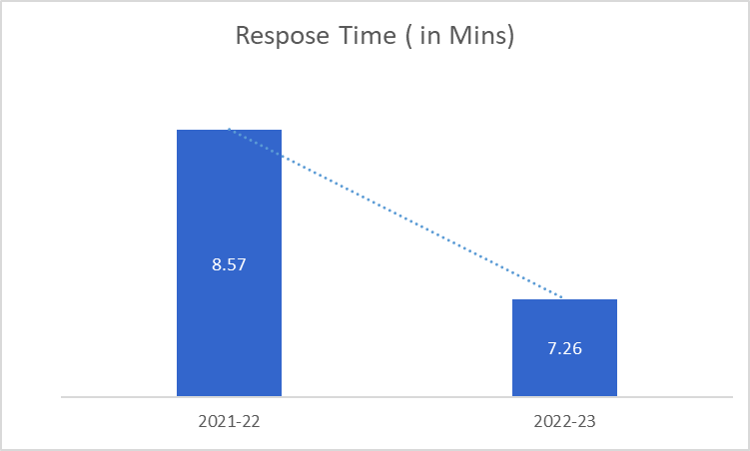
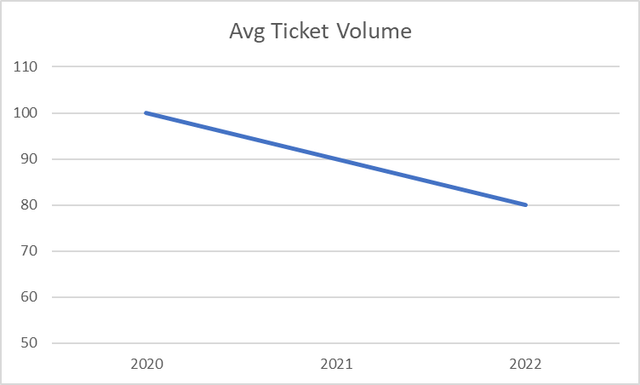

We have brought in best of breed processes, people and technology to VMIE thereby enabling better user experience
Prodapt Achievements in ITHD Services for VMIE
Accelerators deployed
75%
SOP’s & Runbook driven Ops to drive Left SHIFT
Automation
- In First Level Fixes (FLF) which is 10% above the KPI defined
- Compliance to OLA with no Single Major Escalation reported on ITHD team & its activities
- Reduction in Pega Incidents occurrences
- Reductions in ITHD phone Calls
- Reduction in ITHD Ticket volume Y-o-Y.
Process Automation identified & implemented - RPA
100%
Reducing TCO while improving Customer Sat & Service Maturity
Introduced 12 BOTS in total
ACC & Citrix Password Reset BOTS introduced in Jul’21 reducing the time taken of Password Resets from 7+ minutes to 50 seconds
New Starter Pack BOTS introduced in Jun’22 reducing the time taken from for LAN, Apollo, Qfiniti & Finesse User creation from 14+ minutes to 3 minutes
80%
Application Root Cause fixes by performing Historical ticket analysis
Process Standardization to reduce SLA breach & ticket Aging
53%
Productivity Improvements through Tooling & Accelerators
L1 & L2
20%
Investments on Knowledge Retention/Management
Optimized Opex
Stable Systems - 1
Stable Systems - 2
Faster Response
User Experience
27%
Opex Reduction over Two years
20%
Reduction in Ticket Volumes
53%
Reduction in Phone Calls
15%
Improvement in MTTR
50+
Appreciations

Slide 71
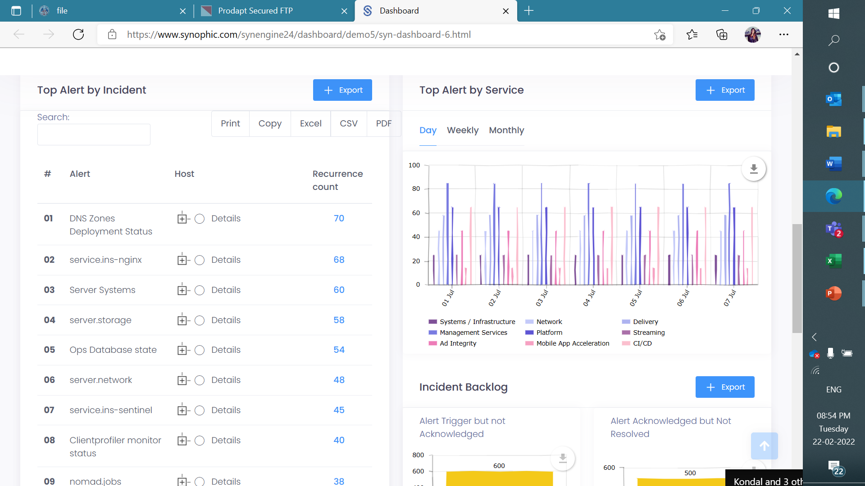
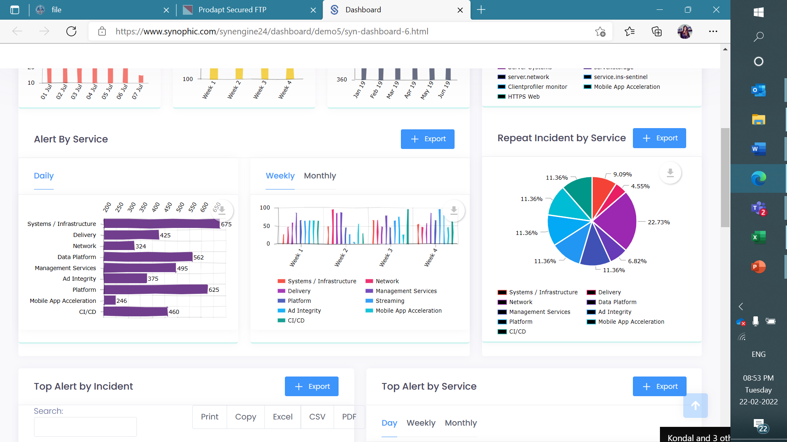
Operations Dashboards to increase focus on Top Alerts & Incidents

Slide 72
Prodapt SLA KPI Compliancy
Priority | Description | Target Response Time | Resolution of overall incident | Communication | Prodapt Compliance
P1 | Refer to the P1/P2 matrix or an outage of an entire system or a revenue generating system. | Manually Generated Incidents:95% in < 15 mins. | 5 Hours Resolution / Target/work Around | Regular communication on an hourly basis to provide progress updates. Email & SMS or as decided by Service Operations. | Comply
 |  | System Generated Incidents: 85% in < 15 mins. | Email or Conference Call each hour.
P2 | Refer to the P1/P2 matrix or Outage of a core service or any issue which prevents more than 5 people from working | Manually Generated Incidents:95% in < 1 hour | 8 Business hours | Regular communication on an hourly basis to provide progress updates. Email & SMS or as decided by Service Operations. | Comply
 |  | System Generated Incidents: 85% in < 1 hour
P3 | Any issue which prevents one person from working | Manually Generated Incidents:95% in < 4 business hours | 20 Business Hours |  | Comply
 |  | System Generated Incidents: 85% in < 4 business hours
P4 | Issues, which limit an individual’s ability to perform their function but does not prevent execution of tasks i.e. degraded performance or issue for which there is an acceptable work around. | Manually Generated Incidents:95% in < 8 Business hours | 80 Business hours | Once Incident is logged, user will receive update within 16 business hours | Comply
 |  | System Generated Incidents: 85% in < 8 Business hours
Proven Operations Engagement within VMIE for the SLA/KPI Compliance with MCC @ 100% & Video Service Delivery (Pre-Prod) @ >95%

Slide 73
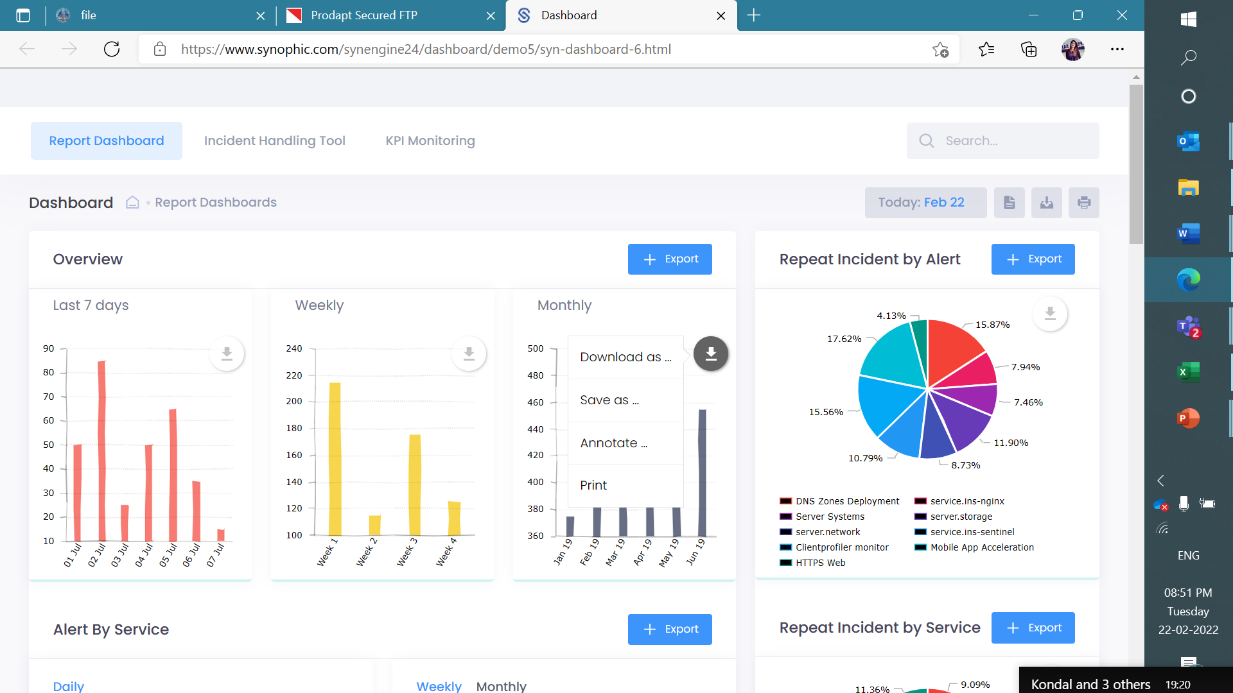
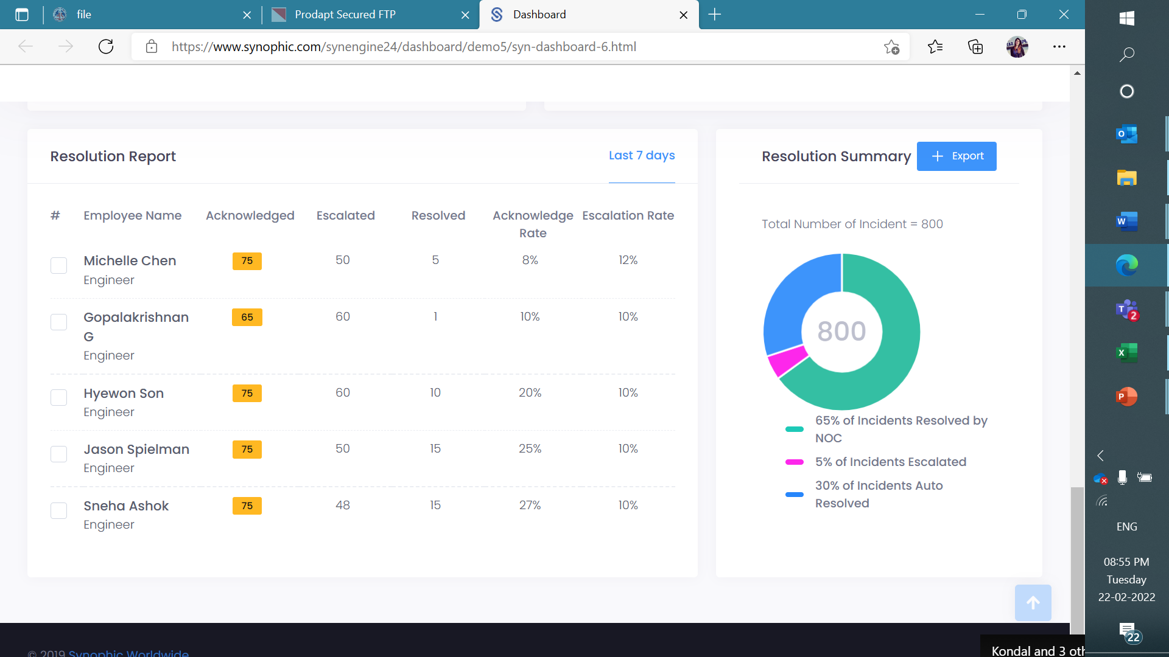
Example SLA KPI Process and Reporting
Sample Dashboard KPI Report
KPI Management Steps Functions
Gather
Maintain and Examine
Determine
Alter KPIs
Tools
* Acquired by Akamai
People
Process

Slide 74
A Timeline of our Operations Revenue: 1) Before Oct 22’ 2) As is 3) Post RfP
Aug’
Sept’
Oct’
Nov’
Dec’
Jan 23’
Feb’
Mar’
Apr’
May’
Jun’
Jul’ Post RfP
Schedule
Schedule 1
Service Desk & Monitoring
€21,166.67
€21,166.67
€21,166.67
€21,166.67
€21,166.67
€21,166.67
€19,000.00
€19,000.00
€19,000.00
€21,166.67
€21,166.67
€68,020.00
€74,5200.00
€70,850.00
€70,850.00
€70,850.00
€111,150.00
€142,370.00
€142,370.00
€142,370.00
€142,370.00
€142,370.00
Schedule 2
App Support
€18,750.00
€18,750.00
€18,750.00
€18,750.00
€18,750.00
€18,750.00
€18,750.00
€18,750.00
€16,666.67
€16,666.67
€16,666.67
€68,020.00
€74,5200.00
€70,850.00
€70,850.00
€70,850.00
€111,150.00
€142,370.00
€142,370.00
€142,370.00
€142,370.00
€142,370.00
Schedule 3
B2B Operations
€32,334.00
€32,834.00
€32,834.00
€32,334.00
€32,334.00
€32,334.00
€32,334.00
€32,834.00
€32,834.00
€32,834.00
€32,834.00
Schedule 4
Network Operations
€68,020.00
€74,5200.00
€70,850.00
€70,850.00
€70,850.00
€111,150.00
€142,370.00
€142,370.00
€142,370.00
€142,370.00
€142,370.00
Schedule 5
Cloud Platform
53,000.00
53,000.00
53,000.00
Schedule 6
Service Management & ORM
€142,370.00
€142,370.00
€68,020.00
€74,5200.00
€70,850.00
€70,850.00
€70,850.00
€111,150.00
€142,370.00
€142,370.00
€142,370.00
Schedule 7
Tiger / MIM
€17,000.00
€17,000.00
€17,000.00
€17,000.00
€17,000.00
€8,500.00
€8,500.00
€8,500.00
€8,500.00
€8,500.00
€8,500.00
€111,150.00
€142,370.00
€142,370.00
€142,370.00
€142,370.00
€142,370.00

Slide 75
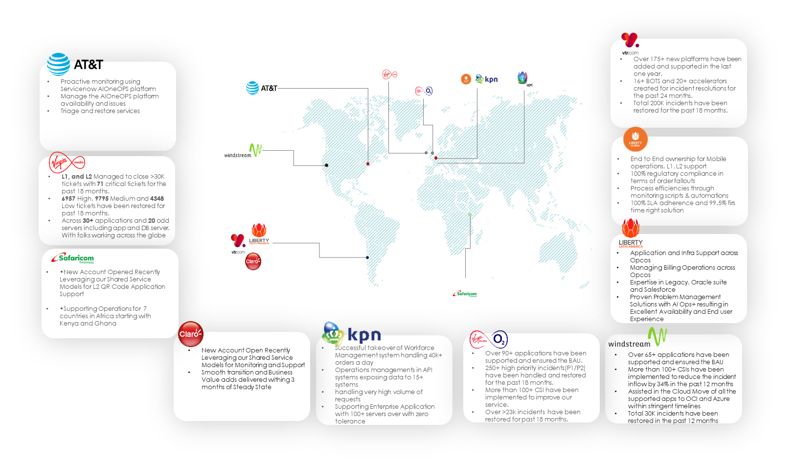
Overall Managed Services Presence

Slide 76
VMO2 Engagement since 2017
2021
2022
75k + Tickets Handled
2022
2022
2020
2020
2020
Prodapt ‘s Journey
2019
123 CSI worth £30K delivered
2017
2018
2023
Process Gearing – Rate Card Mgmt. Tool
Support across 3 locations
Prodapt has partnered with VM since 2017 and has been rendering Compliant operational support for various stacks like OSS, BSS, iCare, CSA & Online-Identity
The trust and credibility which Prodapt has gained over the years paved way in making footprints on various projects which were critical and complex without any glitches
DB Migration & SMS Upgrade
DevOps Deployment & Digital Ops Support
~ 100% SLA adherence
CSAT survey @ 9/10
L2 App Support
L3 Support – NPC/ NKE
Continuous Service Improvements
Dedicated Service Delivery POC
App Service Level Monitoring
Scope Of Work

Slide 77



A glimpse into support of ‘Prodapt -VM BAU Apps Support’ – IPC & Monitoring
High platform stability maintained
5Y Analysis & RCA Action Plan
Improved platform availability
Priority incidents volume reduced
** Until May 2023
Prodapt has been proactive in reducing the number of incidents over the last 5 years.
Reduced incidents by 14% and increased SR by 40% over last four quarters. Prodapt maintains an SLA of over 95%
100+ High performed with >98 % success rate
40 hours of war room to anchor the DB migration collaborating 500+ Business users
Extended Out Of Business Hours support to minimize sales/business impact
Proactive and Preventive measures have brought down 48% redundant outages during peak sales period in 2022
100% automated Daily Health Check Monitoring in BSS/CSA & iCare; Partial automation in OSS/OID
10+ Pre-emptive Digital Monitoring’s facilitation
2 proactive alerts configured in last quarter to prevent the major service/system outage
Unleashing Value for VMO2: Prodapt's Track Record of Reducing Ticket Volume, Continuous Service Improvement and Cost Reduction

Slide 78
Proactive Continuous Service Improvement initiatives undertaken by Prodapt
Continuous Delivery
Excellence
Platform Improvements
Process Re-Engineering
46
45
30
CI/CD/CT Execution
Launchpad to iCare Transformation
End of Life – CMSP DB migration
Rate Card Management
2019-4; 2020-7; 2021 – 9; 2022 -11; 2023 - 14
2019 -19; 2021 -15; 2022 -7; 2023-4
2019 -15; 2020 -3; 2021 – 3; 2022 -6; 2023-3
Effort Saved
Application added into our Remit
1775 Days of Effort Saved
Fulcrum Next Gen - 2020
Audit Referral Form - 2020
Premises Mgmt Apps - 2021
Digital tools support - 2022
6 Small systems - 2022
iCare Platform - 2022
Single View Serviceability - 2023
Volt Order Entry - 2023
** efforts saved are highlighted in the status report weekly & monthly
Effort Savings → Adding additional application in to Prodapt’s scope with
Zero Costs to VMO2

Slide 79
Problem Management – A Journey towards Ticket Reduction
Problem Investigated and fixed to bring down the anomalies
25+ Problem tickets have been raised and fixed in 2023.
Repeated Ticket analysis had significant effect on incident reduction
25% reduction in iCare/LP system
20% reduction in BSS
75% reduction in CSA
Incident Reduction - Prodapt’s current track Record

Slide 80
Contribution to Automation, Process and Platform Improvement
Launchpad to iCare Migration - 500+ man days of effort additionally invested
Migration of Legacy 2008 SQL DB to 2016 version - 40 hours of Change Window
100+ Changes performed
Swift Response reduced Agent wait time from 5 days to 1 day for 750 requests
12 Servers were Added to the Load Balancer and Supported
600+ hours saved for Operations and achieved 9x efficiency
160+ hours of change window reduced
30% ticket reduction was achieved and brought stability
Ops Efficiency
Infrastructure
Credential Migration Tool
Delivery Excellence
1 Database Server
190 SQL Jobs rebuilt
Collaborated with 500+ Business users
38 Databases migrated
5 Application Servers
Case - 3
Case - 2
Platform Improvements
Continuous Delivery Excellence: CI/CD/CT Implementation
Process Improvement: Rate Card Management
CI/CD
200 hours of effort to implement DevOps in BPT application
Downtime Reduction during deployments by nearly 60+ hours since 2021.
CT
360 + test cases across multiple browsers
Automated daily Sanity Pack in health check ensuring 100% application/service availability
480+ hours of manual testing eliminated
Rate card Process re-defined for VM Planner & Admin Team to reduce Products’ rate updation from 5 days to <1 min
Approx.. 12000+ products’ rates/year on year updated
DIY
cutting down Ops dependency
100%
3600 hours of effort saved for operations team 7200 hours of wait time saved for business
Case - 1
Case - 4
2021-15hrs; 2022 -30hrs; 2023 – 15hrs
2021-2880hrs; 2022 -2880hrs; 2023 – 1440hrs

Slide 81



Above & Beyond for Care Small Apps over the Years…
Enhancements of Applications
SMS Application Server & Database Server Migration
Volt Order Entry Issues & SMS Application Upgrade
Audit Referral Form is a new application designed as a value add for Virgin Media to capture details and images for Auditing purposes for various contractors working for VM
Engineering Timesheet application used by multiple agents for filling their timesheets was given a total overhaul, which helped various teams to ensure cost calculation for various engineers at the end of month
Upgrade of the legacy SMS database to its 2016 version allowed for extended support from Microsoft also allowing for enhanced security and faster response from queries
Performed an interim fix of the legacy SMS Web Service logic to mitigate SMS failures. This fix allowed for the SMSs in the legacy platform to flow through by increasing the timeouts and ensured that the SMSs are delivered to the customers within the Virgin Media space
Performed database upgrade to its 2016 version for 30+ applications as a value add on for VM . This mitigated the risk of marinating the application in the legacy platform allowing for extended support from Microsoft, DBA & for enhanced security and faster responses
Performed automated daily reporting for SMS Stats for stakeholder visibility which allows for a bird’s eye view of the state of the SMS and allows for analysing the trends of the SMS volume and delivery of the messages
Volt Order Entry, an application for placing SIM cards for O2 customers was taken into support without any extra FTE.
Proactive monitoring & 02 engagement for VOE application was done for highlighting various issues with the downstream teams. This allowed for the engagement of various O2 team and raise concern to mitigate any current/potential issues by establishing a chain of communication between the Virgin Media & O2 space
Upgrade of SMS application was done to the latest technology with 20x faster performance and 90% less failures. This facilitated various business to send SMSs to the end customer within the time windows of 300ms and allowed for other dependent teams like IVR for automated completion of the customer journey
2020-21
2023
2022

Slide 82




Above & Beyond for OID over the Years….
Automation
Process Improvement
Marketing Value
Migration activity
Store deployment script automation – Created and successfully tested the store deployment script from a single hopbox (server) instead of manual deployment on each of the 10 servers in Preprod and 12 servers in Production. Achieved Efficient Deployment with reduced manual effort
Crontab setup - Automative Scripts setup in the application servers to clear the diskspace upon reaching a threshold automatically. Reduction in incidents from 3-4 tickets a month to nearly null.
Automated sanity tests - Selenium Script to perform a quick application testing the application after a change – both deployment and support changes
Automation of AEM Content Deployments (Changes to virginmedia.com site) – Efficient mechanism and manual effort reduction - Effort Saving: 20 hours effort per month.
All file transfer applications which existed within VM Ops were migrated from File Transfer Protocol to Secured File transfer Protocol. This activity & initiative was performed without any costing to the customer which had multiple teams’ involvement and coordination
Proactive monitoring setup - Applied email alert mechanism when the replication queue got blocked in AEM by setting up rules for splunk transactions. As a result, reduced 10 reactive activities and saved 2 hours per month.
Applied email alert mechanism when the replication queue got blocked by setting up rules for splunk transactions. As a result, reduced 10 reactive activities and saved 2 hours per month
Incident Reduction from 10K to less than 500 in 6 weeks’ timeline. This is an addition to the existing BAU activities during the peak season. Actively worked in bringing down the inflow from an Avg of 100 to 60 by Left shifting.
Opsgenie callout as part of proactive monitoring
Jira Service Management – Record the event of the incidents and its actions.
iPhone Launches : Provided extensive support for iphone 12,13,14 launch which was a great success..Ensured 100% availability of VM platform with proactive monitoring. Validations of changes on dependent environments to pre-empt any issues to the launch.
Black Friday Launch : Highly focused support for successful black friday launch targeting a higher volume of year end sales. Verification and Validation of Changes on the platforms to pre-empt the potential impact on sales.
HTTP2 Implementation on virginmedia.com is completed in order to upgrade the site security protocol and thereby achieving the higher SEO rating for the site which is a key factor in digital marketing
Played a critical role in AEM 6.4 upgrade from 6.2 as part of AEM upgrade project within 4 days without impacting any of the existing platform & this was achieved with zero postproduction implementation & with in planned changed window.
Successfully migrated the Java version from 1.7 to 1.8, tomcat version from 7 to 8 along with code deployment in SSO application. Preparation activities includes upgrade, server configurations, application configurations and logging mechanism. Migration activity has been carried out directly in production environment and achieved zero incidents post migration.
Store Preprod Server Migration and setup – Server migration from Bradford to Knowsley that includes server setup, migration of code and configurations, connectivity establishments.

Slide 83




Above & Beyond for Operational Service Support over the Years….
Monitoring
Process Improvement
Migration
Scope Expansion
Additional manual efforts were put in to proactively monitor the server health of Single View Serviceability application to ensure there was no impact during Black Friday Sale.
Proactive monitoring & manual triggering of Badger job was done to prevent an intermittent job failure and to ensure the required data was delivered to dependent systems without impact business.
Proactive monitoring is being done for a server which is part of GIS system (Gcomms) to prevent the connectivity issues and to reduce business impact.
Premises data sharing activity is being performed every month and it has been added in our additional support scope. This data will help Virgin Media to process vast majority of existing customer package changes.
New training environment has been set up in GIS system(Gcomms) which allows users to utilize the account for training purpose and to get hands on in the application.
Additional support provided for continuous project releases in our GIS system as part of network expansion project.
The file transfers in Fulcrum application has been migrated to Secure File Transfer Protocol due to legal security requirement. This has been implemented without any extra cost to Virgin Media.
Rewritten the existing pack export functionality in latest technology without any extra costing which reduced the impact faced by planning team.
Fulcrum NexGen Application has been taken into our support scope without any additional Full Time Equivalent which enables Virgin Media's network planning to grow faster.
Premise Management Application Support has been taken into scope without any additional Full Time Equivalent.
Networks Application L2 Support has been taken into scope without any additional Full Time Equivalent.
Single View Serviceability Application L2 Support has been taken into scope without any additional Full Time Equivalent.

Slide 84


Above & Beyond for Operational Service Support over the Years….
Geographic Information Systems Dataset Load
Security Overhaul of Fulcrum Application
Prodapt has kept Virgin Media’s GIS Systems up to date (GCOMMS/NexTool/Networks) by updating dataset load regularly which gives an opportunity to expand Virgin’s business in network expansion.
Effort has Increased from 08 hours/week →16 hours/week
Security upgrade to protect and maintain the integrity of Rate Cards (Costing) among various partners was implemented by Prodapt
Within 8 weeks
Unsecure rate
Secure rate
Additional Application Support
Below applications have been taken into scope for support over the years without any extra FTE
2020
Fulcrum NexGen Application L3 support
2021
Premises Management Application L3 support
Networks Application L2 support
2023
Single View Serviceability Application L2 support

Slide 85
Modernization work taken up proactively to improve user experience
Breakdown : 2019-20 : 14 → 2021 : 6→ 2022 : 3
Audit Referral Form
Supermail
Upgraded to the latest .NET Framework / .NET Core Platforms
Performed as a part of Continuous Service Improvement
3000+ hours of Efforts invested to modernise
Mitigated security issues & Improved response rate
Civils Team Audit
Field Call Logger
Marketing
Optin
Non Serve
Leads Form
Engineering
Timesheet
Lightning Helpdesk
Worklist
Non Serve CR
999DB
System
Maintenance
PDA Forms
Online Incident
Reporting
Standby & Overtime Capture Form
Construction
Database
Mates Rates Staff
Incentive
Payplan
People Finder

Slide 86
Incidents & its SLA Comparison of Various Suppliers with
Prodapt
Prodapt’ s Incident Count has been consistent and was reduced towards the end of Q4 compared to other suppliers
Prodapt has maintained its SLA well & above 95% compared to other suppliers

Slide 87
Service Requests & its SLA Comparison of Various Suppliers with
Prodapt
Considering high volume of Service requests throughout the year, Prodapt has maintained its SLA of 98 to 99%
Tech M, Service Requests SLA is below 80% throughout the year which is the lowest among all Suppliers.

Slide 88
VMO2 ETOM Operations Framework
Operations
Operations Support & Readiness
Fulfilment
Billing & Revenue Management
Denotations
Market Sales Domain
Market Sales Domain
Market Sales Domain
Prodapt Apps ( 110 )
Product Domain
Product Domain
Product Domain
Customer Domain
Customer Domain
Customer Domain
Non-Prodapt Apps (59)
CSDC
Bulk SMS Cable & Mobile
SMS Web Service
DM Lookup Tool
Online Incident Reporting
VMR Reporting
TMM / VMTP (Control Panel/reporting)
Super mail
VOE(Volt Order Entry)
Gateway
ADDTT
ADDVT
PCI DSS(Fraud Notify)
PCI DSS
MWM Back up solution (VMTP)
Marvin SMS service
TMM- SMS Reporting
Outage Communicator SMS service
CCS Number Management System
Phone Directory
999DB
Marketing Optin
One CMS
Store
Mobile Portal
One line
XML REACH
Non-Prodapt High Volume Tickets (9)
Infohub
Tele sales bundle builder
Cable MyStreet
Retailer Store
iCare
Launchpad
Care / Help
TV Anywhere
MyVirginMedia
JOIN/ Sales
Card Point Admin V2
Phixflow
ICOMS
Netezza
Discover
CJM
EVO
LP Lite
Information Centre
Non Cust Info Centre
Connect App
CLDAP
IDLDAP
Trinity
Sky Sports
E-Billing
MyBill
Technologies
Dotnet/VB/C# Technology
EECC Dashboard
MuleSoft
SamKnows
Text Tool Application
IDS
IDSP
Abinitio
FUSION
MSA
Akana
MDM
VMB Salesforce app​
Force
ETA Direct (Oracle Field Service)
NextGen
Engage
Comet
JAVA
Outage Communicator
Mobile Outage Communicator
O2 Identity
CDO Apigee
CIO Apigee
Tele sales Lead management System
IVR
VM Store
TV Control
5th Basket Page
Converged App
E-Billing Mobile USD
Angular
Service Domain
Service Domain
Service Domain
CoreTechs
AUPA
Field Call Logger
FieldTech
FormsDB
Intranet Forms
SSO
Time & Attendance
CSS
Toast
Laser
OSS Admin Portal
BPT
EIF
.Dotnet CRM
Mint UXP WebAuth
MyVMChatApp
Auth Z
Ping Federate
WifiSharing
DEES
Auth WS
Shared Hosting
Atlassian (Product)
Prime-Ecommerce-API
WebSafe Portal
MyVMAppLab
Contractor Payments
PEGA
BOSP
SCV
BIS
SDA login Portal & WIFI Sharing Resource server
TVAS
SMB eCommerce & DEP
Amdocs CRM
Resource Domain
Resource Domain
Resource Domain
Appian
Engineering Timesheet
Construction Database
Office Wiki
PIC_Tracker
System Maintenance
SKU Upload
Worklist
PDA Forms
NexTool
Planning Tool
PMM
Gcomms
FON
SVS
Fulcrum
TROT
Salesforce
Badger
Payplan.
MiddleWare/ Database
Remedy Application
ODS
Rizzo
O2 Netcracker
GXO
Hudson
Cramer
VMB Smart Planning
RI
iPMM
Engaged Party Domain
Egain Technology
Engaged Party Domain
Engaged Party Domain
PHP
Enterprise Domain
Enterprise Domain
Enterprise Domain
MuleSoft
Common Process Patterns Domain
Common Process Patterns Domain
Common Process Patterns Domain

Slide 89
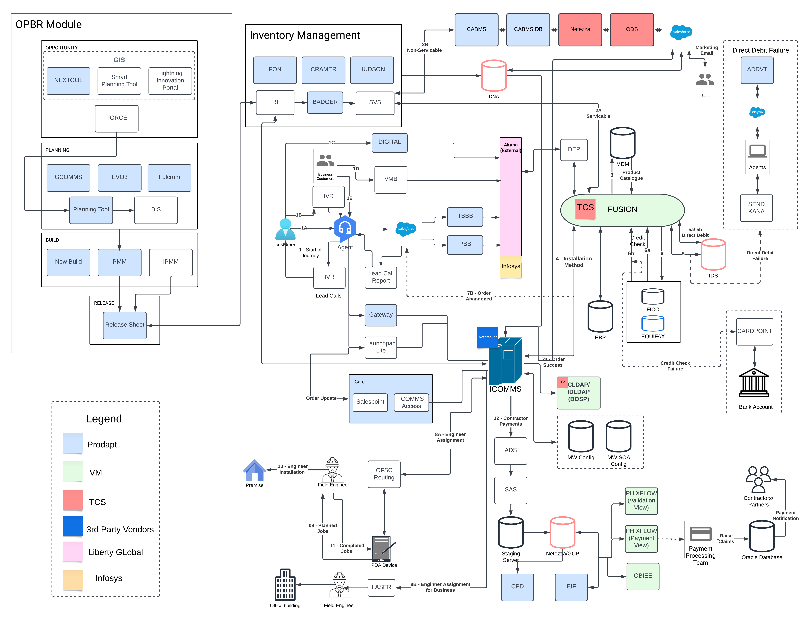
Our Understanding of a Customer Journey in VM O2
CTO
CDO
CIO

Slide 90
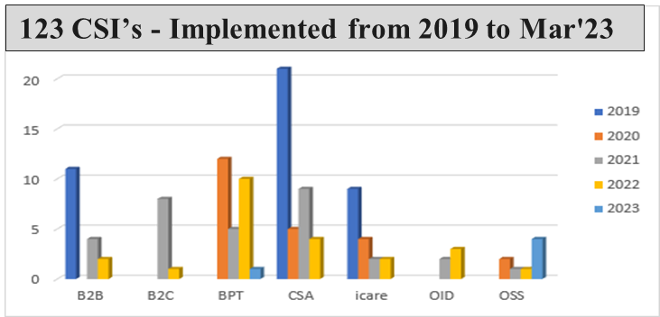
Prodapt has developed subject matter expertise across the 5 towers enabling better user experience and Opex reduction
Additional Application Support
2020
Fulcrum NexGen Application L3 Support
2021
PMM L2, L3 Support
Badger L3 Application Support
2023
SVS Application L2 Support
VOE Application Support L2 & L3
BSS
CSA
iCare
OSS
OID
15 Applications | Customer Management Tools | Pricing Tools | Billing Tools | CSS | Resource Management Tools
37 Applications | VM Intranet Forms | SMS Applications | Volt Order Entry | Agent Tools Forms DB | Super Mail
2 Applications | iCare | Launchpad |
12 Applications | Resource Inventory Tools | FON | Fulcrum Applications | GIS | OSS Admin Portal | Toast | Premises Mgmt. |
28 Applications | Cloud Based Applications | Authentication Tools | VM Customer Dashboard | Agent based tools Customer Provisioning tools | Content Management Tools | Tools Cable My street | Shared Hosting | VM Intranet Tools
Prodapt has implemented DevOps for Business Pricing Tool Application with dedicated CI/CD/CT pipelines which reduced downtime by 80% and has saved 350 hours of effort as on date.
Proactive Modernization
Classical ASP to .Net | 20 Apps
Windows WPF to ASP .Net 2.2 | 1 App
Classical ASP to .Net Core 3.1 | 1 App
100%
Service Level Targets
43
Automations / Accelerators
58
Platform/Process Improvements
75%
Resource Continuity

Slide 91
We have analyzed a set of add-on applications in the portfolio and can bring in committed improvements
Application Name | Count of Tkts / yr
BOSP | 13787
EVO | 8261
Data Support | 8091
Discover | 4526
Remedy | 4292
Icoms | 3952
CJM | 3752
Force | 2022
E-Billing | 1849
Connect app | 1760
VMB Sales Force | 1600
Outage Communicator | 759
Fusion | 728
VM App | 644
BIS | 450
Myvm | 445
RI | 167
ETADirect | 114
Launchpad Lite | 76
Egain - IC | 76
CardPoint | 58
Trinity | 52
Comet | 33
SCV | 32
5th Basket | 28
Credit Check | 22
CenterView | 16
Non cust info centre | 15
IVR | 15
Gateway | 11
Miami | 11
MyBill | 3
iPMM | 0
VMB Smart Planning | 0
Potential 15 K Ticket Reductions
BSS
CSA
Proactive Monitoring / Health Checks
~ 60 k Incidents
35 Applications
5 Towers
OSS
Process Reengineering / Shift Left
iCare
OID
Automations & Self Help

Slide 92
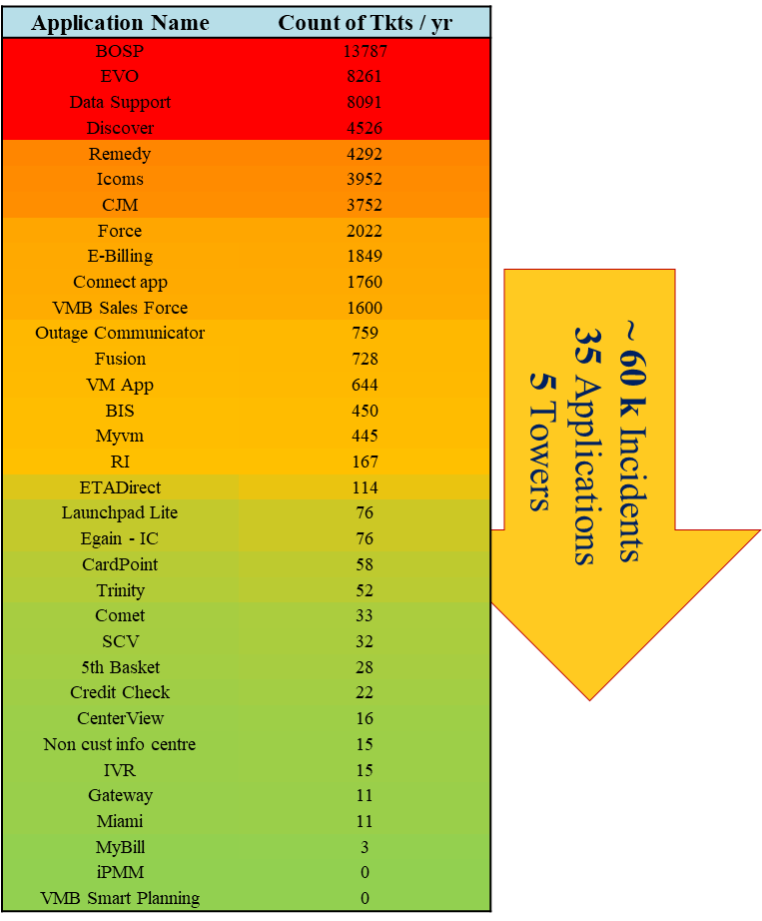
Our CSI approach of Process Improvements and Automations may yield positive results for allied systems too
12% Left Shifting
Automated UI for L1 to fix user Issues
Defined SOP s for effective resolution
20% Automation
Request to Complete Automations
Automated Jobs for Clean up
Standalone tools / UIs to ease User
Scripting SOP’s
DB Scripts
10% Process Re-Engineering
Proactive Monitoring tools
Pre - Health Check before BAU
Data Sync Automations to prevent discrepancies
6% of Automations can be Implemented
4% of Left Shifting
4% of Process Re-Engineering can be done
Reduce 8k tickets ~ 13% of Total Volume 60k in 1 year

Slide 93
End State Architecture – Application Sunset
Assessment to define different patterns for retiring, with solid strategies
1. Size and complexity 2. Technology/app architecture 3. Data requirement frequency and size
Application Mirroring
Application Sunset
Report only Apps
Unified Appstore
Build application in cloud and keep in suspended mode if data can only be accessed using app
Move to archival type storage in cloud for data that does not need frequent access and can wait for 24 hours+ lead time for retrieval
Archive only database and identify the macros for required data
Data only on raw storage format in cloud
Cut down the cost of the infra & data
Maintain Petabyte size of data quite easily & cheap

Slide 94
Evolution of iCare – a quick recap…
Launchpad to iCare migration has been carried over for a period of 12 to 15 months. Prodapt was involved in supporting both Launchpad and iCare together and facilitated the agents to have a gracious movement
Q1 2022
Q2 2022
Q3 2022
Q4 2022
Q1 2023
12 hrs of non stop Marathon engaging DBA, Wintel, and Network teams to facilitate iCare server high change
6 Phases of iCare Server change in Pre-Prod & Training env
6 Phases of iCare server change in Production which includes,
1 Medium Change &
5 low changes
Session loads & Exception monitoring's were performed
Deployed iCare DPA sprint changes and corresponding warranty fixes in production environment
Deployed iCare Mobile sprint changes and followed by 12 Agent Feedback/defect fixes has been deployed
iCare access provisioning was done, and the build has been deployed to over 700+ Laptop users and all Citrix servers.
Credential Migration tool was developed as part of CSI to migrate user’s integrated application credentials from Launchpad to iCare, which saved 350+ hours of effort throughout the migration.
Proactively monitored the user logs and identified users who are frequently experiencing fatal errors in LP.
Contacted 100+ users and advised them to switch over to iCare with a demo. Received (+)ve feedback from the agents about iCare
Provided iCare access to 400+ users based on Adhoc request from the iCare support group
Handled around 750+adhoc email requests
Deployed around 12 iCare Agent Feedback/defect fixes, resulting in better iCare consistency and performance.
Aggressively migrated 6k+ users in a months time accommodating 8 different phases using Credential Migration Tool
Deployed the iCare Memory Improvement Changes and successfully added 12 new servers in
Prod (6) &
Pre-Prod (6)
Performed exception analysis for all iCare Server changes, DPA and Mobile sprint and Defect fixes to identify any new exceptions or spikes in existing ones
Identified whether previously fixed exception were reoccurring.
Post migrating to iCare, clean up is in full swing for LP
Clean-up has been successfully done in,
UAR
App Role
Hosted Controls
Received 20+ shouts in a month's time for addressing the agent issues with quick fixes
To increase the stability of the platform incorporated few alerts, 1 time DB clean up & holding pages to prevent usage during crucial backup procedures

Slide 95

L1 - ITOPS transformation using Generative AI
L1 Support Using Generative AI – Managing Order Fallout tickets in CRM/Provisioning App
Traditional L1 Process Flow
Generative AI Process Flow
Wait Time
Wait Time
L1 team can use GenAI against CRM, Provisioning, Inventory and related Infra issues handled using SOPs
66% improvement in MTTR
85% wait time reduction
70
85% Wait Time Reduction
60
9
mins
mins
Business User creates ticket
5
User reports issue to Generative AI Tool
2
3. Corrective
Steps
Ticket Assigned from Q to L1 team
Gen. AI recommends steps for user corrections
Solution
SOPs
30
15
Helpdesk
Agent
1
mins
2. Known Issue
L1 - Checks for SOP
Gen. AI creates ticket for unknown issues
1. Issue
5. Unknown
Issue
30
5
Ticket
Assignment
2
Synapt
6. Ticket
Classification
Ticketing
Portal
mins
Ticket
Creation
Issue
Analysis
User
L1 – Verifies the issue in CRM
10
User
Ticketing
Portal
L1
Engineer
KMDB
2
Gen. AI classifies & assigns Ticket to L1
2
mins
8. Issue
Analysis
7. Ticket
Assignment
L1 - Checks error code /logs handling SOP
10
Ticket
Triage
5
L1 – uses Generative AI to research KMDB articles
5
10. Ticket
Triage
9. L1 Corrective
Actions
User
Notification
L1 Corrective
Actions
mins
L1
Engineer
L1 – Verifies in Provisioning App
15
2
Gen. AI recommends fixes on CRM & Provisioning App
2
13. Update
Ticket
Issue
Analysis
Corrective
Actions
mins
12. Corrective
Actions
11. Issue
Analysis
L1 - Corrects the data & reprocess the Order
5
L2
Engineer
Relevant App
Solutions
L1 - Corrects the data & reprocess the Order
5
Relevant App
L2
Engineer
Solutions
Ticket Closed and user notified
Update
Ticket
Ticket Closed and user notified
5
5
14. User
Notification
70 mins
66% MTTR Reduction
24 mins
Demo

Slide 96

L2 - ITOPS transformation using Generative AI
L2 Support Using Generative AI – Managing Provisioning Order Failures in Inventory App using Generative AI
Traditional L2 Process Flow
Generative AI Process Flow
Wait Time
Wait Time
L2 team can use Generative AI in Complex Data corrections, Config issues for fix recommendations
80% improvement in MTTR
90% wait time reduction
70
90% Wait Time Reduction
15
165
mins
Business User creates ticket
mins
User reports to issue to Gen AI Tool
30
5
2
3. Corrective
Steps
mins
Ticket Assigned from Q to L1 team
Helpdesk
Agent
Gen AI recommends steps for user corrections
Solution
SOPs
15
2
Issue Analysis and Triaging
Gen. AI creates ticket for unknown issues
2. Known Issue
30
1
1. Issue
4. Unknown
Issue
Ticket
Creation
Ticket
Assignment
Issue
Analysis
Gen AI
Ticket Assignment to L2 Engineer
Gen. AI classifies & assigns Ticket to L2
Synapt
5. Ticket
Classification
Ticketing
Portal
15
User
Notification
Ticketing
Portal
L1
Engineer
KMDB
1
User
120
L2 verifies qualification & product details in OM
Ticket
Triage
L2 – uses Generative AI to research solution
6. Ticket
Assignment
mins
15
Update
Ticket
2
7. Issue
Analysis
8. Corrective
Actions
9. Update
Ticket
L2 verifies order orchestration logs in Inventory Management
15
Issue
Analysis
Gen. AI recommends NGMSS data fixes to L2
2
Data Fix
L2
Engineer
L2 verifies daGta entries in OM & Inventory system for RCA
Solution
Relevant App
L2 – Validates the fixes
60
5
L2
Engineer
Data
Fixes
Solutions
User Process
Issue
15
Executes data fixes & reprocesses the order
15
15
L2 - Executes data fixes & reprocesses the order
15
mins
SOPs
mins
10. User
Notification
Ticket Closed and user notified
5
Ticket Closed and user notified
5
175 mins
80% MTTR Reduction
35 mins

Slide 97
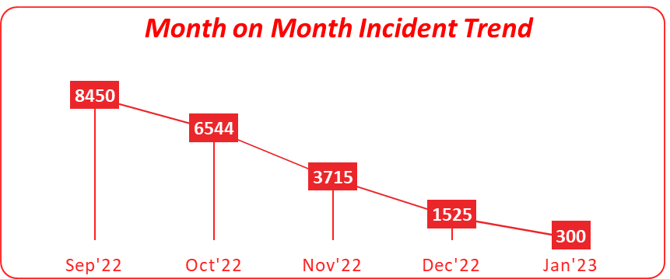
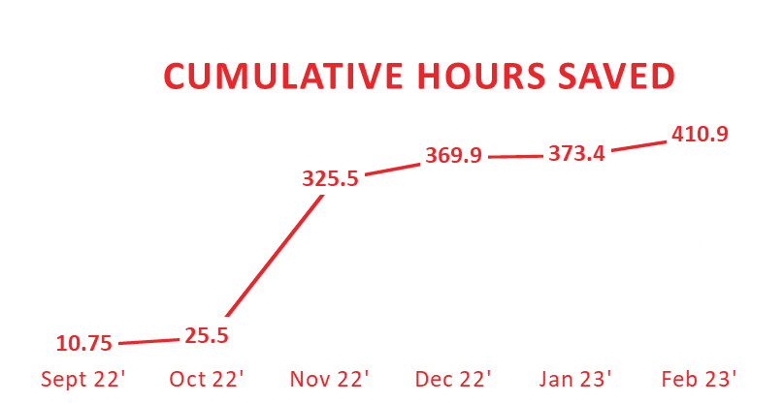
Values Already Delivered - We have brought in best of breed processes, people and technology to VMO2 thereby enabling better user experience and Opex Reduction
Values Already Delivered - We have brought in best of breed processes, people and technology to VMO2 thereby enabling better user experience and Opex Reduction
50%
Reduction in Change
Window
100%
Availability – Through Automated Health Checks
20%
Reduction in Volume of
Tickets
BSS
96%
Increased SMS delivery
rate
6 sec - 0.3 sec
Faster SMS response
rate
95%
VOE Ticket
Reduction
CSA
750 Hours
Deployment Time
Saved
60%
Investments/efficiency in supporting both the platforms
40 –> 8 Hours
Turnaround - for all Service Requests
iCare/Launchpad
4
Critical Applications additionally Scoped In
13+
Small Projects Delivered with 0 defects
2K+
Hours saved by incorporating Process improvements
OSS
9K
Backlog Tickets Closed in 6 Weeks Span
6+
Preventive Actions To Reduce Outages
76%
Inflow Reduction Over Last
Two Quarters
OID
Credential Migration Tool
Movement of 7k+Users during Icare Migration. Saved around 350 hours in 5 months
60%
Investments/efficiency in supporting both the platforms

Slide 98

Prodapt Operations summary – On IPC & Monitoring
Prodapt’ s Incident Count has been consistent and was reduced towards the end of Q4 compared to other suppliers
Repeated Ticket analysis had significant effect on incident reduction
75% reduction in CSA
25% reduction in iCare/LP system
20% reduction in BSS
Proactive and Preventive measures have brought down 48% outages during peak sales period in 2023.
25+ Problem tickets have been raised and fixed in 2023.
** Until May 2023
Prodapt has been proactive in reducing the number of incidents over the last 5 years.
100% SLA has been met.
100+ High performed with >9 % success rate
Extended Out Of Business Hours support to minimize sales/business impact
40 hours of war room to anchor the DB migration collaborating 500+ Business users
100% automated Daily Health Check Monitoring in BSS/CSA & iCare; Partial automation in OSS/OID
Preventive maintenance and housekeeping
10+ Pre-emptive Digital Monitoring’s facilitation
2 proactive alerts configured in last quarter to prevent the major service/system outage
Prodapt has substantially played a vital role on demonstrating ITIL Framework in all its deliverables

Slide 99
VMO2 Applications outside of Prodapt managed estate if combined may reap greater benefits
Forecasted Volumetrics per Annum
15K tickets + 60K to be handled
250 + 2K Priority tickets to be handled
1000+ changes to be Implemented
80+ NPC/NKE closed
VM O2 Application Support Maintenance
BSS
CSA
iCare
OSS
OID
15 Applications | Customer Management Tools | Pricing Tools | Billing Tools | CSS | Resource Management Tools Engage | VMB Salesforce | Fusion | XML Reach | NextGen | Trinity | PhixFlow | Force | Card Point | E-Billing | EECC Dashboard
37 Applications | VM Intranet Forms | SMS Applications | Volt Order Entry | Agent Tools | Forms DB | Super Mail Remedy App | IVR | Fusion MW | O2 Identity | O2 Net cracker | Text Tool App | Netezza | Information Centre
2 Applications | iCare | Launchpad | 5th Basket | CJM | Discover | EVO-360 | SamKnows | Launchpad- lite
12 Applications | Resource Inventory Tools | FON | Fulcrum Applications | GIS | OSS Admin Portal | Toast | Premises Mgmt. iPMM | BIS | Resource Inventory App | ICOMS | RIZZO | ODS | SCV | VMB Smart Planning
28 Applications | Cloud Based Applications | Authentication Tools | VM Customer Dashboard | Agent based tools Customer Provisioning tools | Content Management Tools | Tools Cable My street | Shared Hosting | VM Intranet Tools| IOS & Android - Connect App | Converged App | Sky Sports | TV Control | VM Store
Functional towers
Tech-Stack

